Slide 1


NETCCN
Provider Workflow
Wickr Pro & Sidecar
October XX, 2023

Slide 2
Getting Started – Provider on Mobile

Slide 3
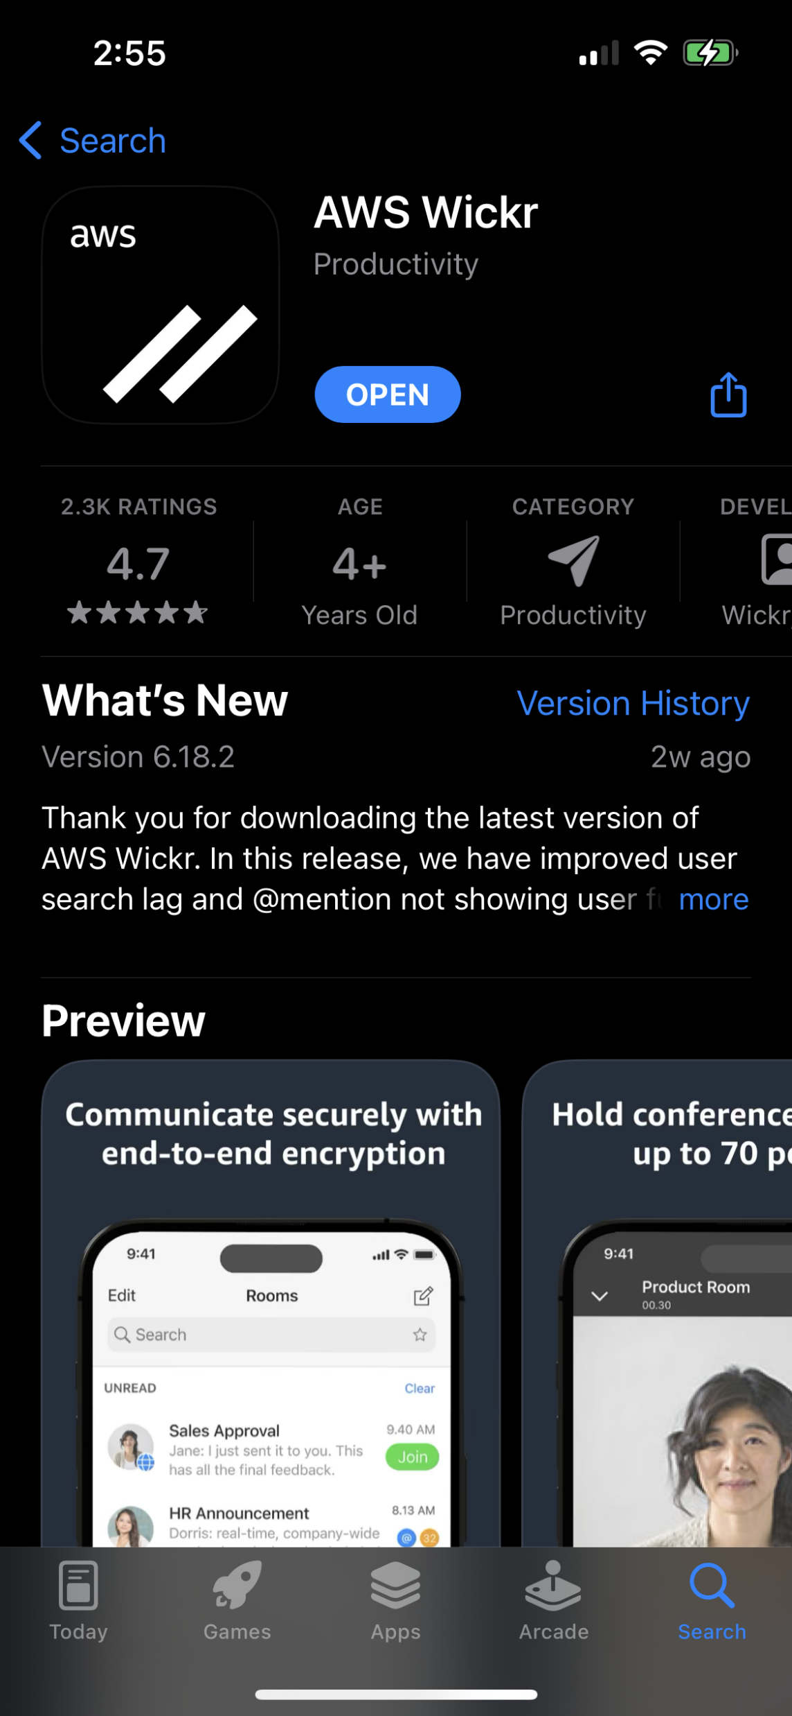
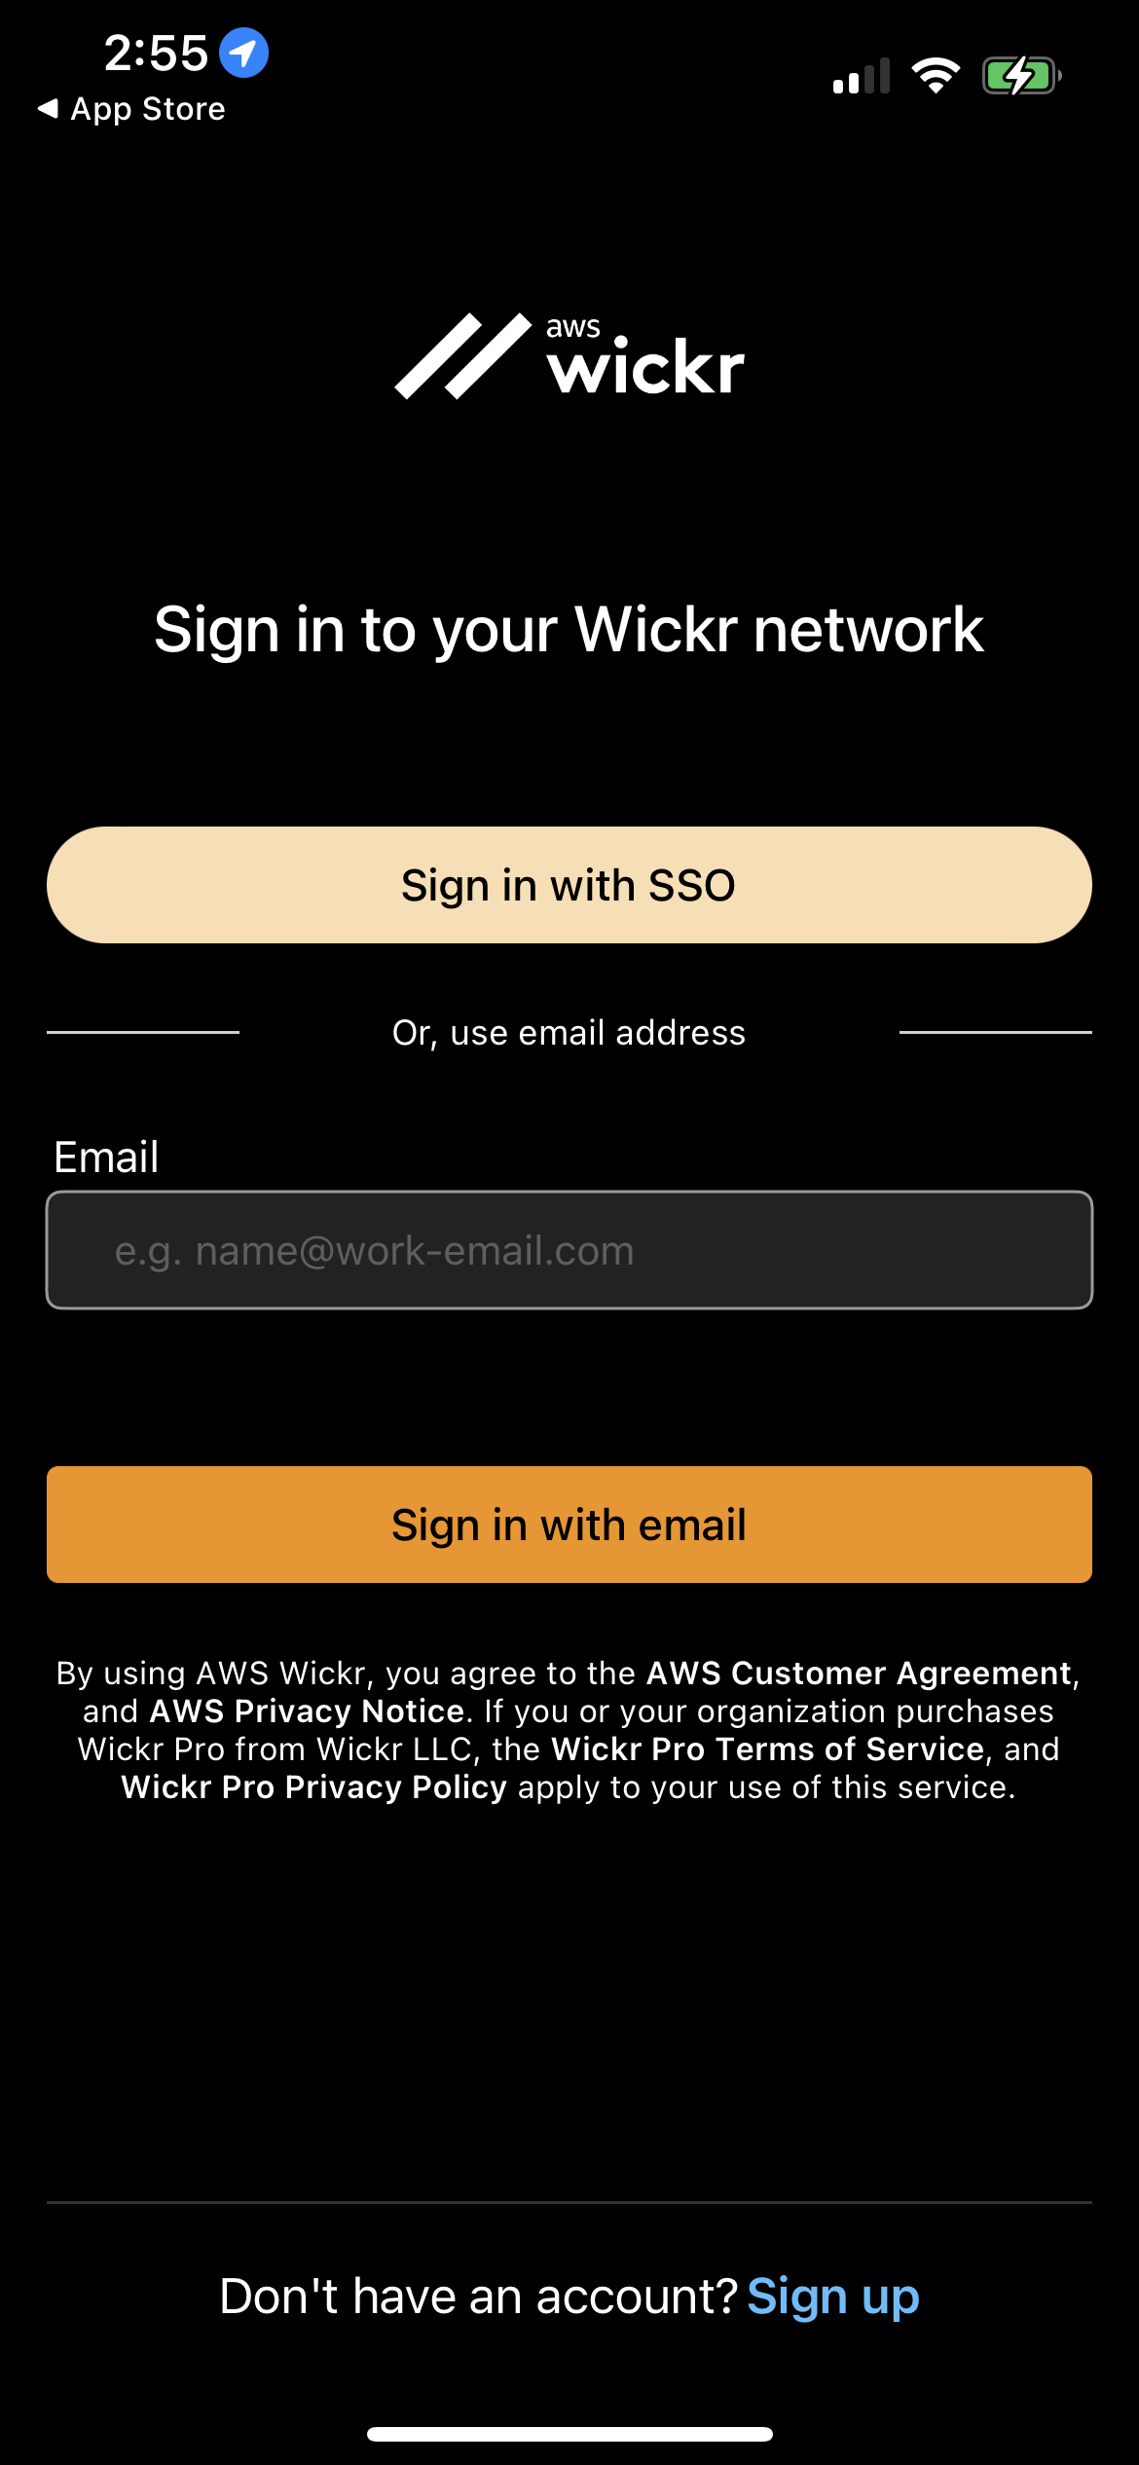
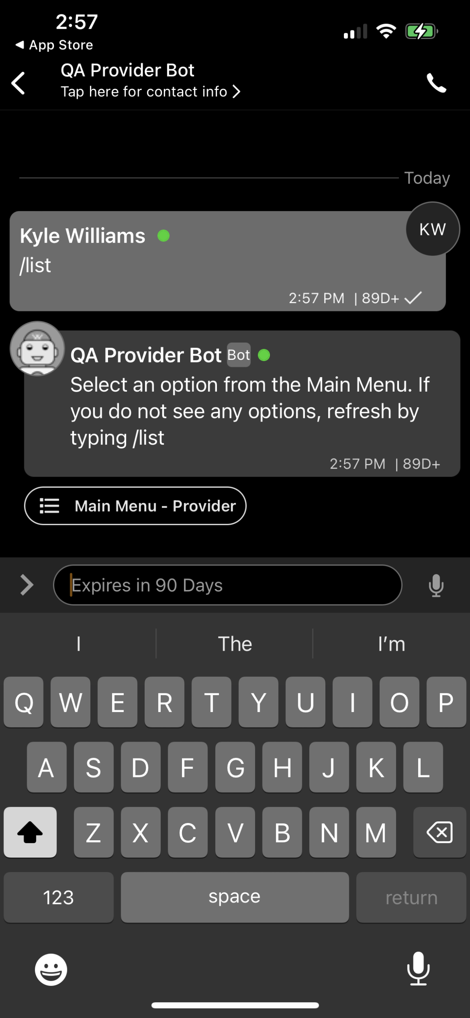
QuickStart Instructions – AWS Wickr
Download, log in, and begin using the app
Your site’s provider bot may be named differently. Check with your admin or instructor
1
2
3
Download AWS Wickr from the App Store or Google Play Store
Sign in with your provided login credentials.
Create a Direct Message with QA Provider Bot to access the Main Menu

Slide 4
Patient Navigation

Slide 5

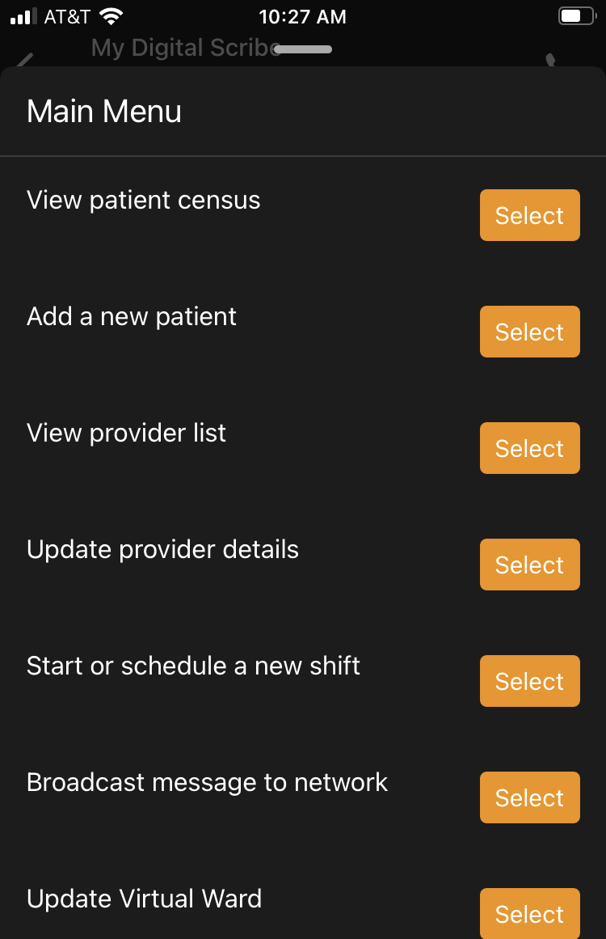
Wickr Telemedicine Features – Patient Navigation
Wicker provides an encrypted secure platform for managing patients across multiple sites, conducting consults, and transferring patients between sites
My Digital Scribe
Home Menu
Patient Navigation
Review Patient Records
From the census, drill down to view patient details, including demographics, medical history, and recent documentation
Add, Edit, and Search Patients
Add, update, search, transfer, and manage patient records
Document Care
Record encounter notes, take vitals, document conditions and medications
Document Patient Encounters
Update patient info, demographics, vitals, condition, diagnosis, treatments, medications, allergies, immunizations, and add notes
Create Patient Consult Rooms
From Patient Details, click ‘Create Room’ to start a consult Room with the Care Team to collaborate
Telehealth Consultations
General Consults
View providers by specialty and duty status. Conduct a consultation with an on duty provider
Share Files
From Provider List, select a provider to automatically start a consultation where users can share patient records, voice memos, photos, videos and geolocation.
Patient Consults
Start a consult with a provider of a specific specialty from a patient encounter. Share patient details with on duty providers sorted by specialty.
Conduct Consult
Conduct general or patient consults and share patient details, upload attachments, take pictures, record audio, hold audio and video calls, and share location data
Connect over Audio/Video
Initiate calls with optional video to receive real-time guidance around treatment

Slide 6
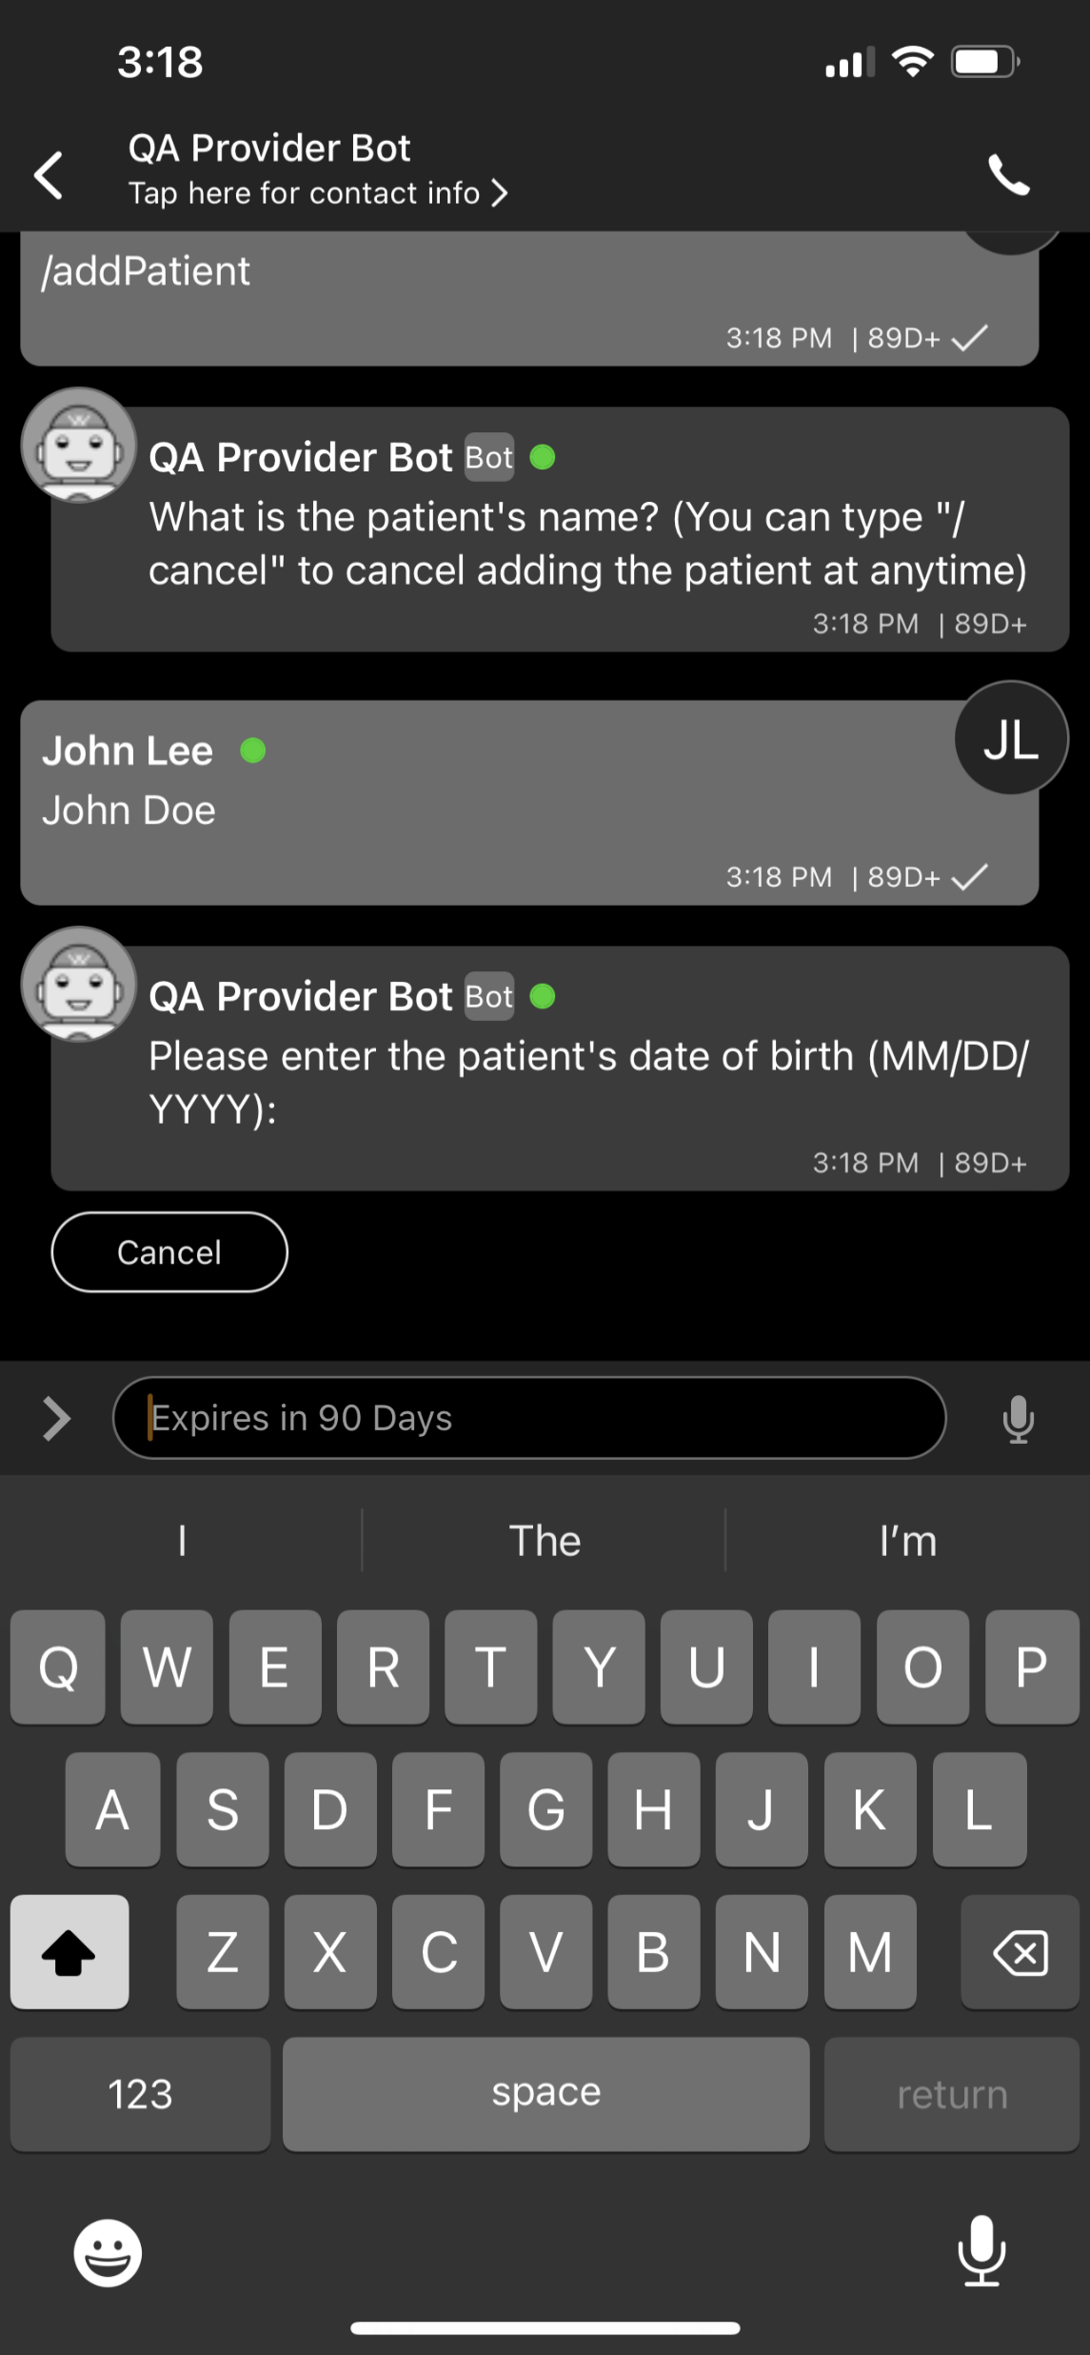
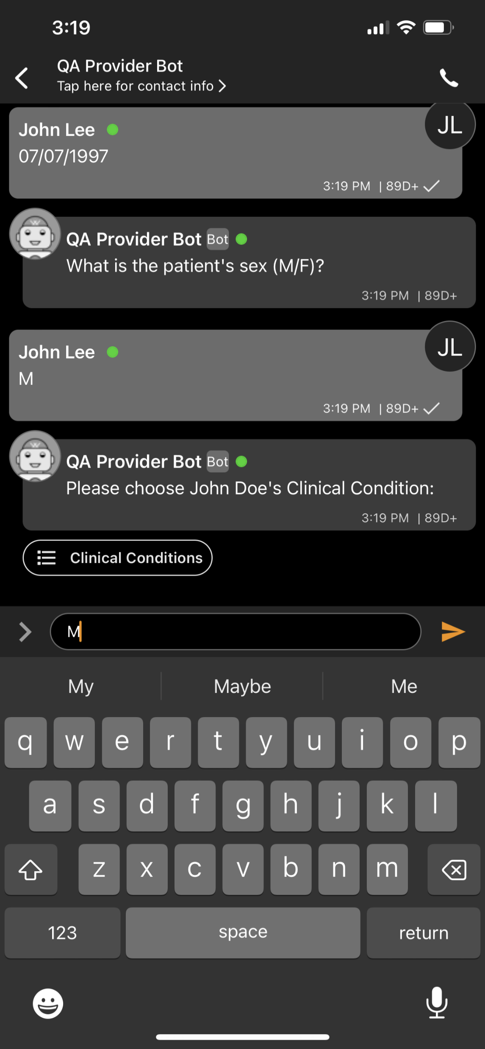
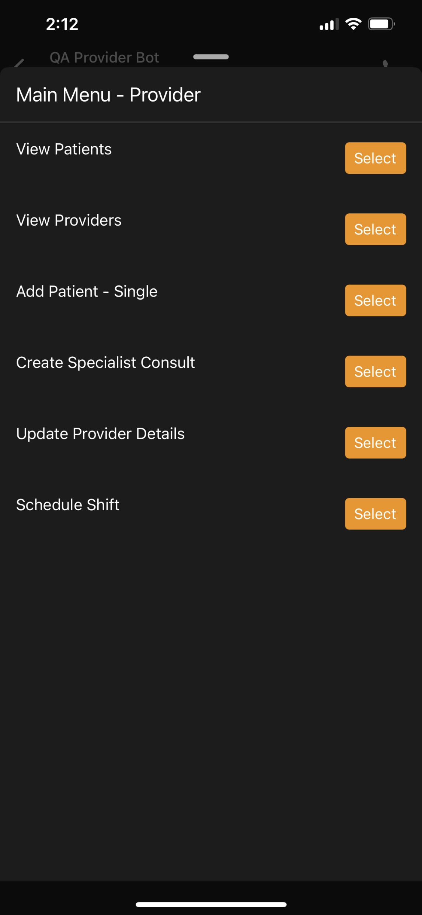
Add New Patient
Key Functionality Overview
At any time type “/list” to return to the main menu
Type the patient’s first and last name
Once prompted enter the patients first and last name in order without punctuation. (e.g. John Doe)
Type patient’s date of birth
Enter the patients date of birth as MM/DD/YYYY, (e.g. 01/31/1995
Select the patient’s sex as assigned at birth (confirm)
Either select “M” for male or “F” for female. Or you can type the letter “m” or “f” for male or female.
Add Patient - Single
From the home menu select Add Patient - Single

Slide 7
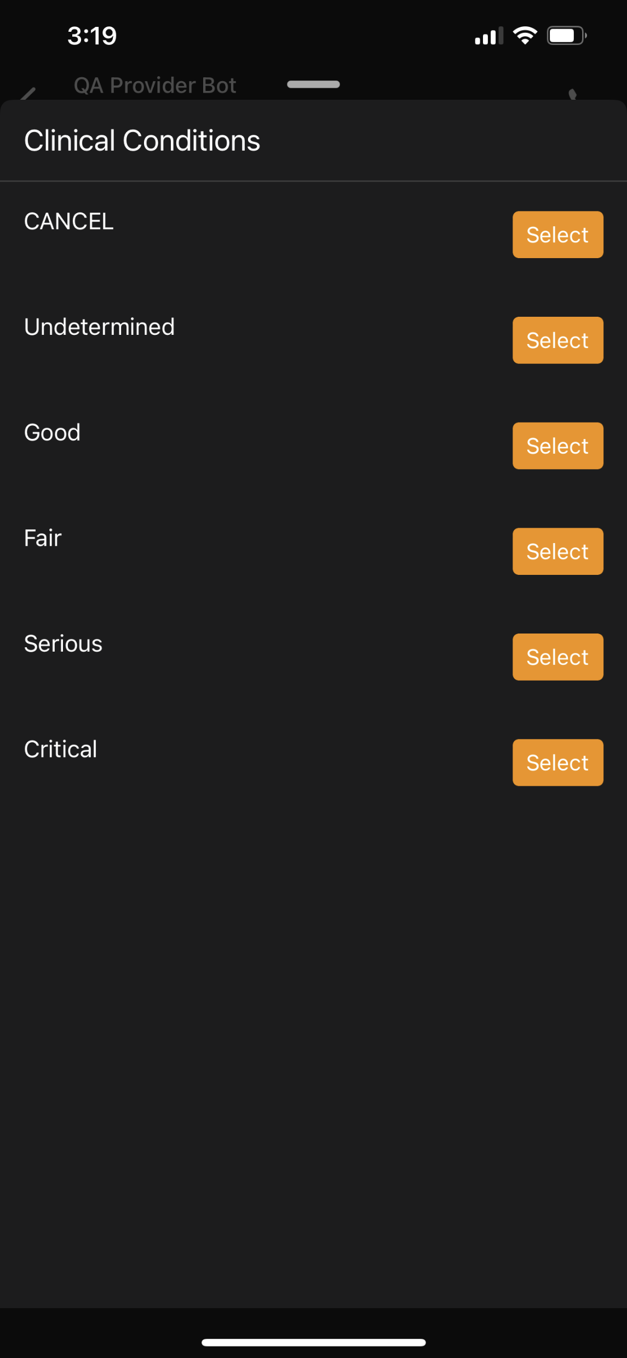
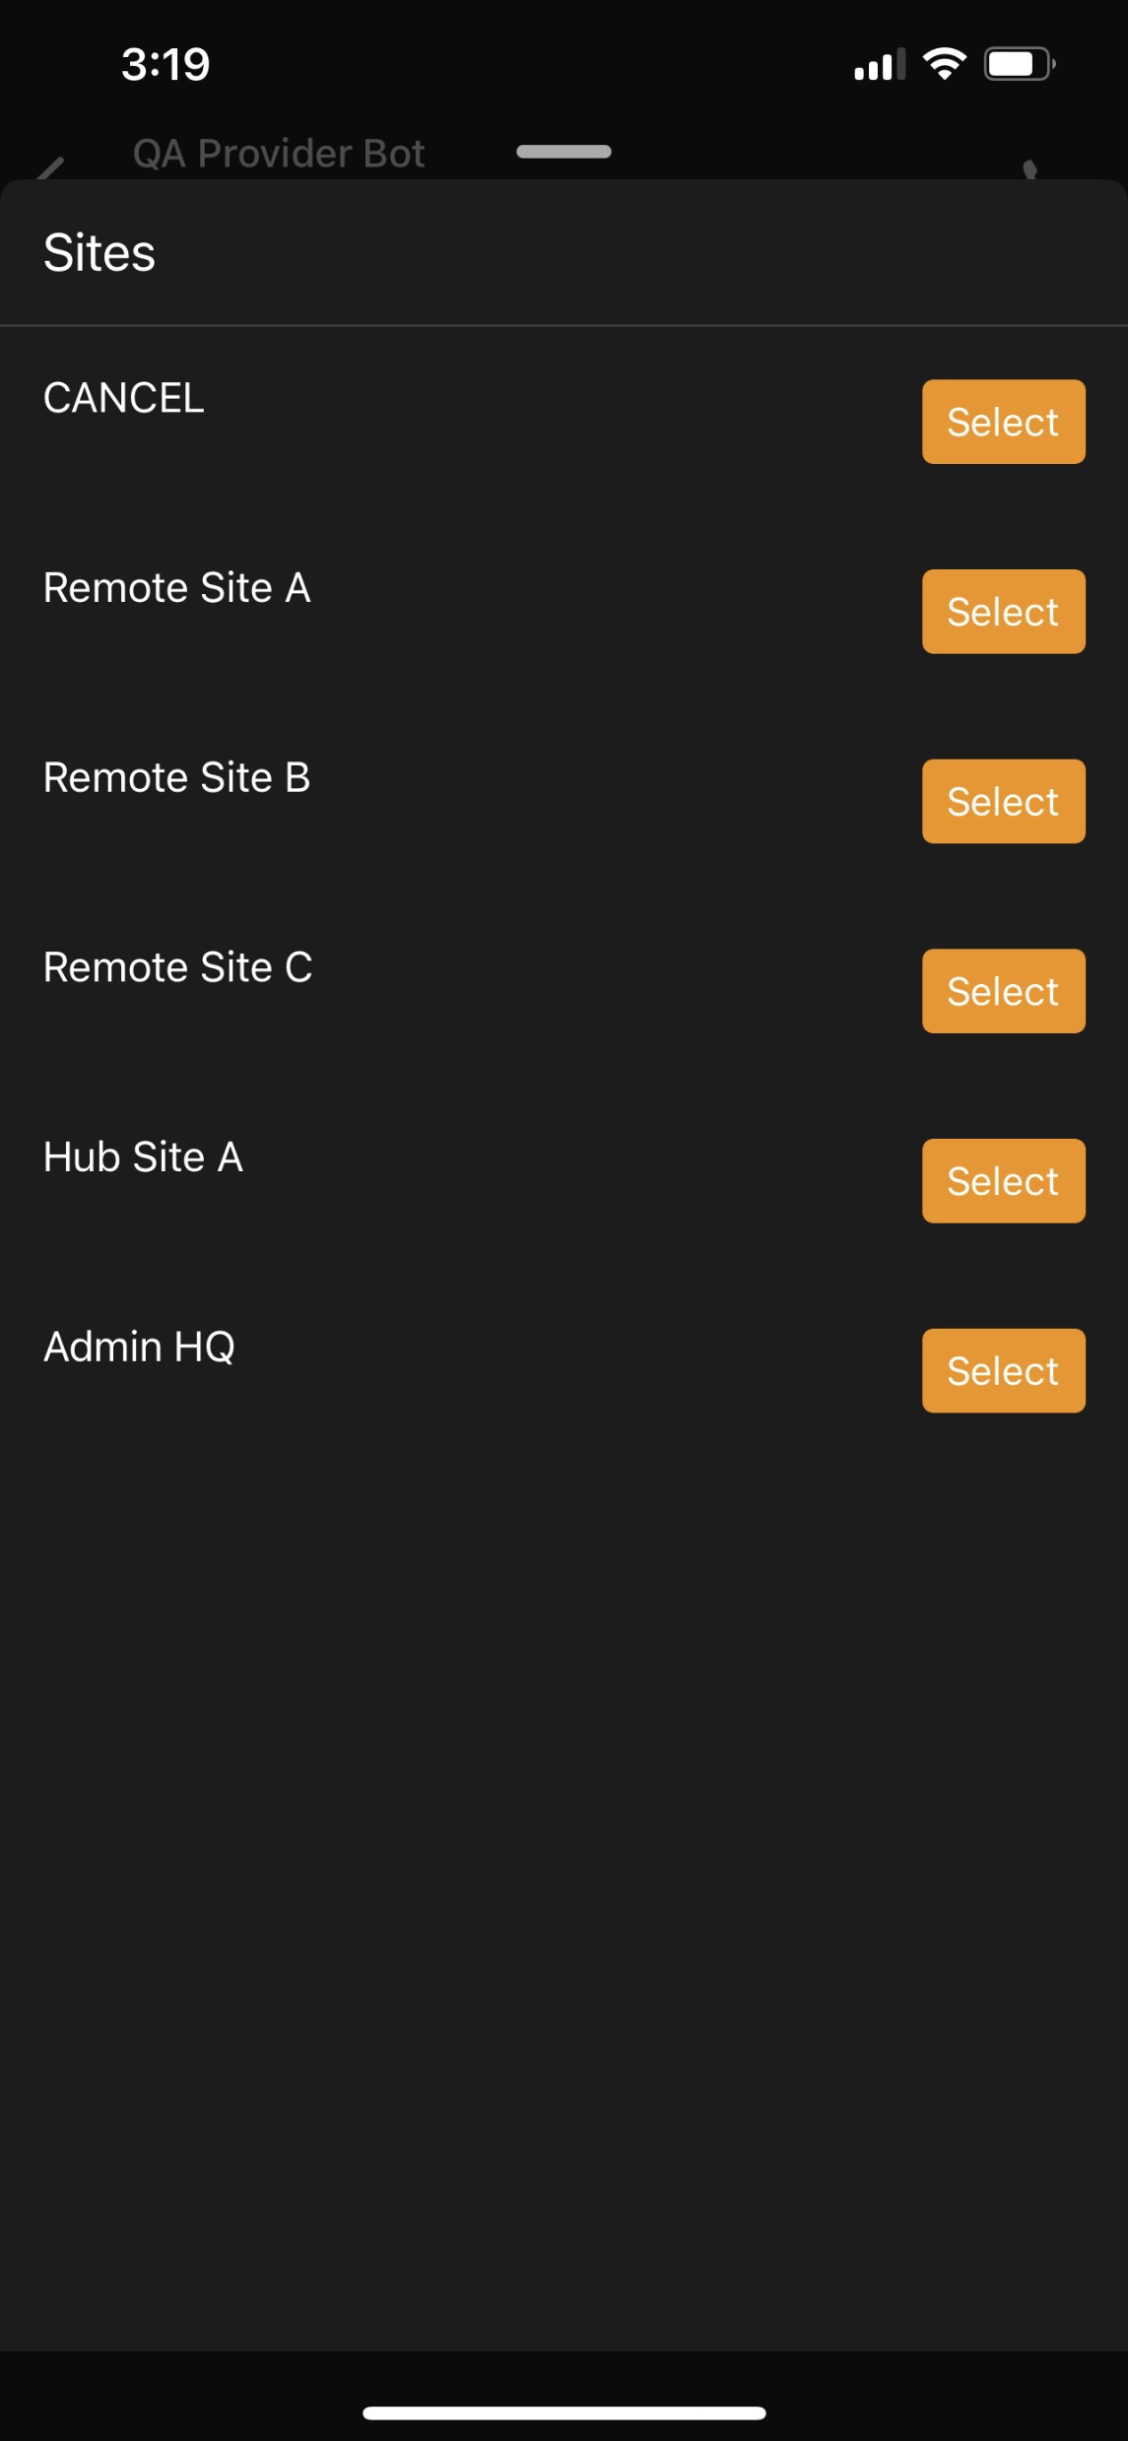
Add New Patient Cont’d
Key Functionality Overview
All information entered here can be edited later from the patient record.
If you encounter an error or need to exit to the home screen at anytime you can type “/list” and press enter.
Select the patient’s Clinical Condition
Select the current clinical condition of the patient.
Choose the patient’s site
Select the site that the patient is at. The patient will be shown in a list of patients at that site but can be transferred to a different site at any time.

Slide 8
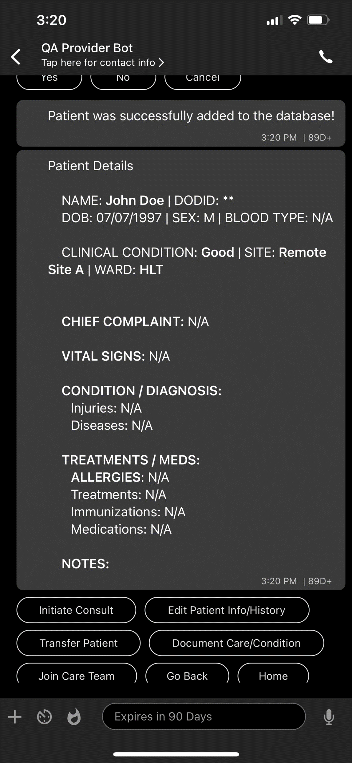
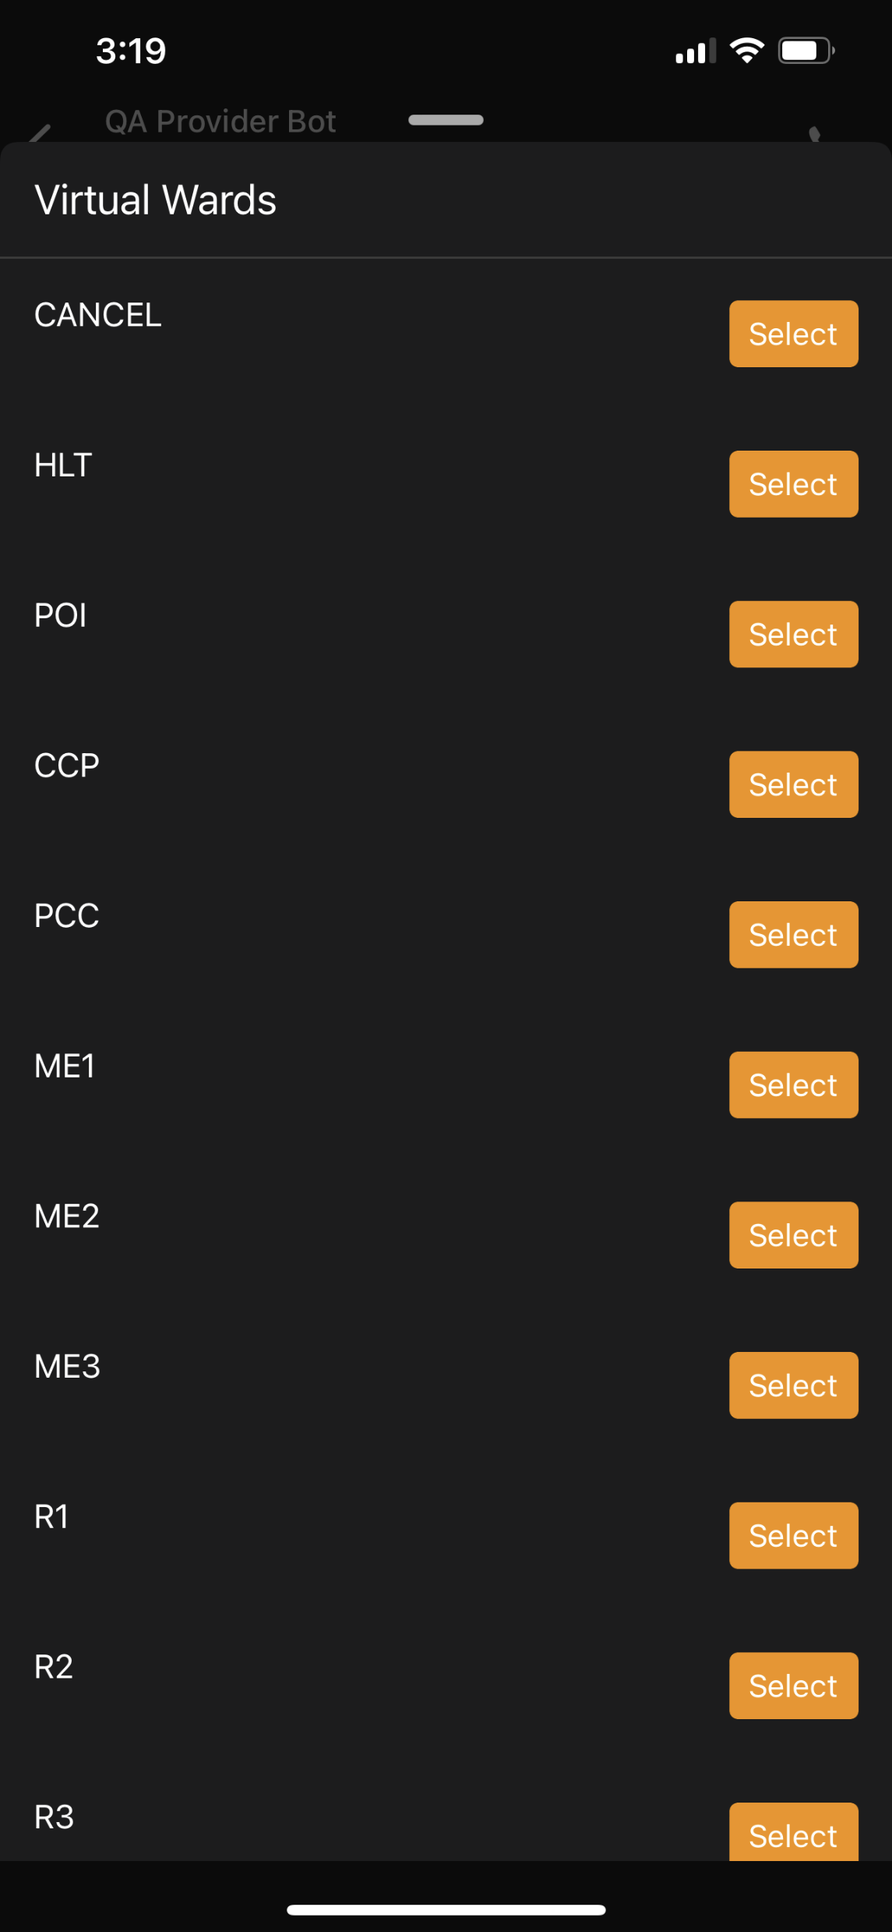
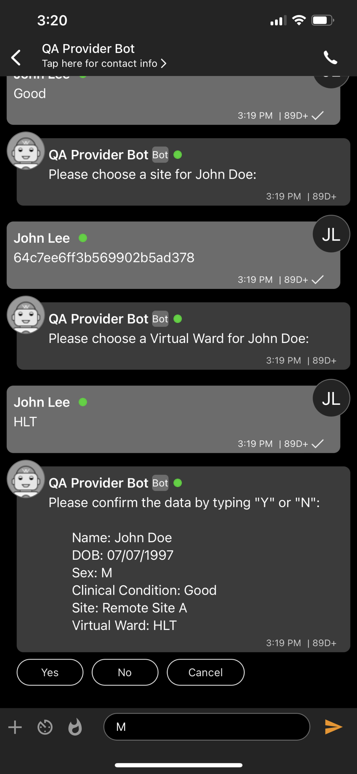
Add New Patient Cont’d
Key Functionality Overview
Choose a virtual ward for the patient
Need clarity on what a virtual ward is
Confirm the data displayed is accurate
The patient data entered will be displayed. If the data is accurate press or type “yes” if there are errors type “no”. If you select yes the record will be created and opened. If no is selected you will be returned to the home screen
Record is created
A message indicating that the patient was added to the database will be displayed followed by the patient record

Slide 9
Search for a Patient

Slide 10
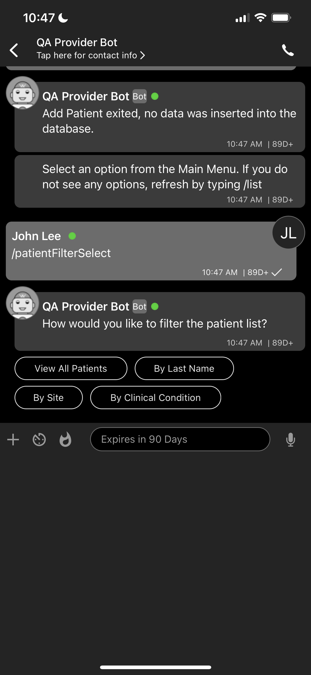
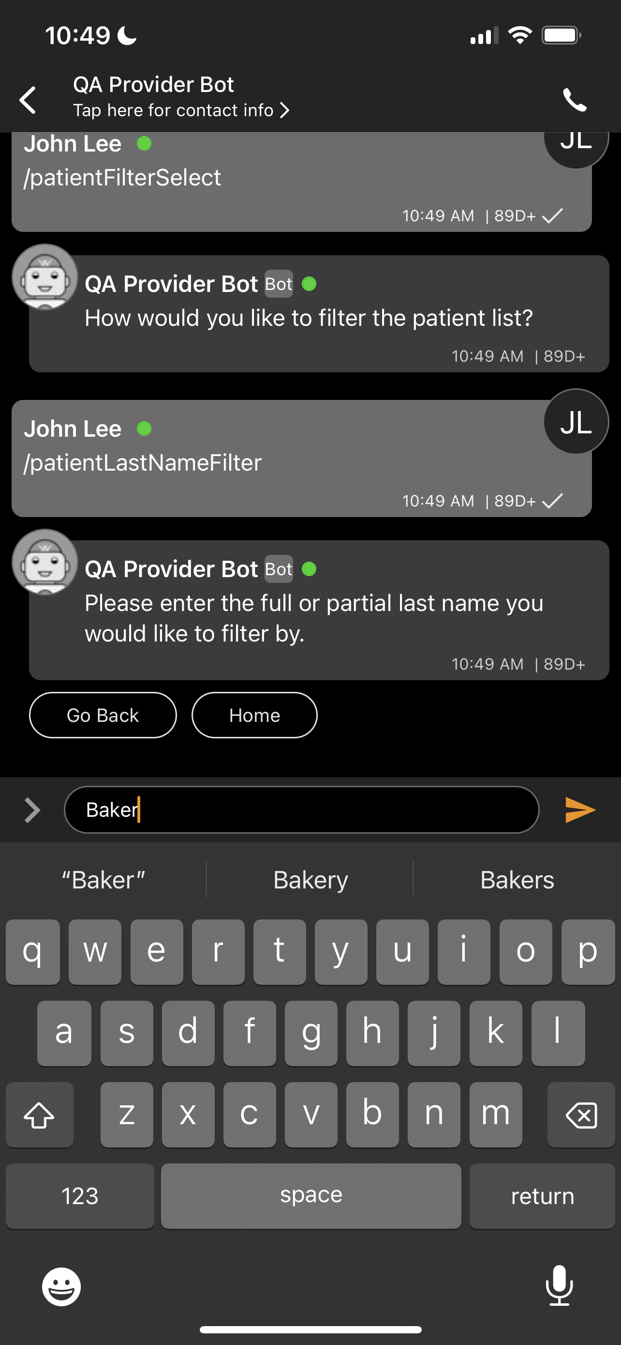
Search for a Patient – By Name
Select “By Last Name”
If “View All Patients” is selected a list of the patients will be displayed in alphabetical order by patient name.
Select “View Patients” from the main menu
Enter “/list” to open the main menu
Enter the last name of the patient you wish to find

Slide 11
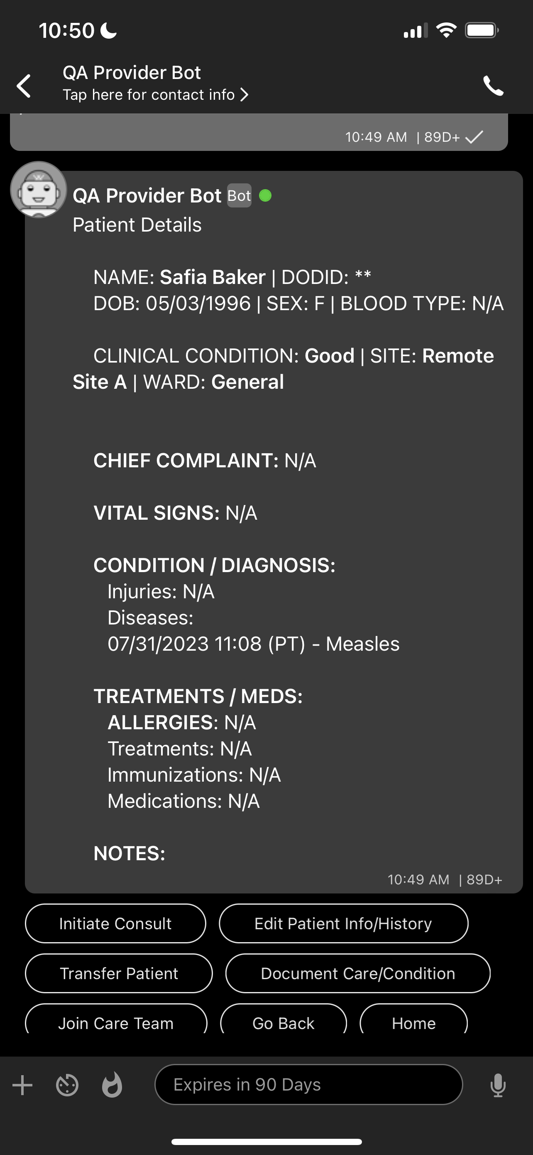
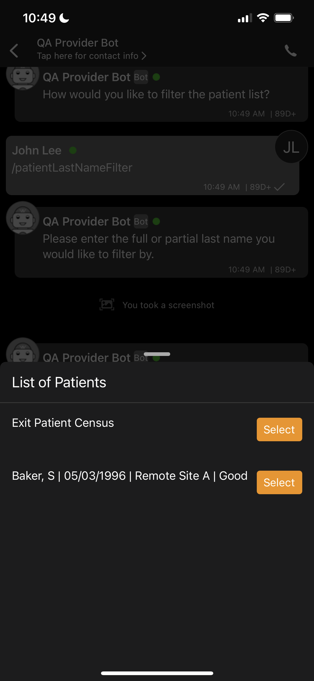
Search for a Patient – By Name Cont’d
Select the patient you wish to view and the patient record will be displayed
If there is no matching patient select “Exit Patient Census” to return to the main menu
A list of the patients with a matching last name will be displayed
First initial, Date of birth, site they are associated with, and clinical condition will also be displayed

Slide 12
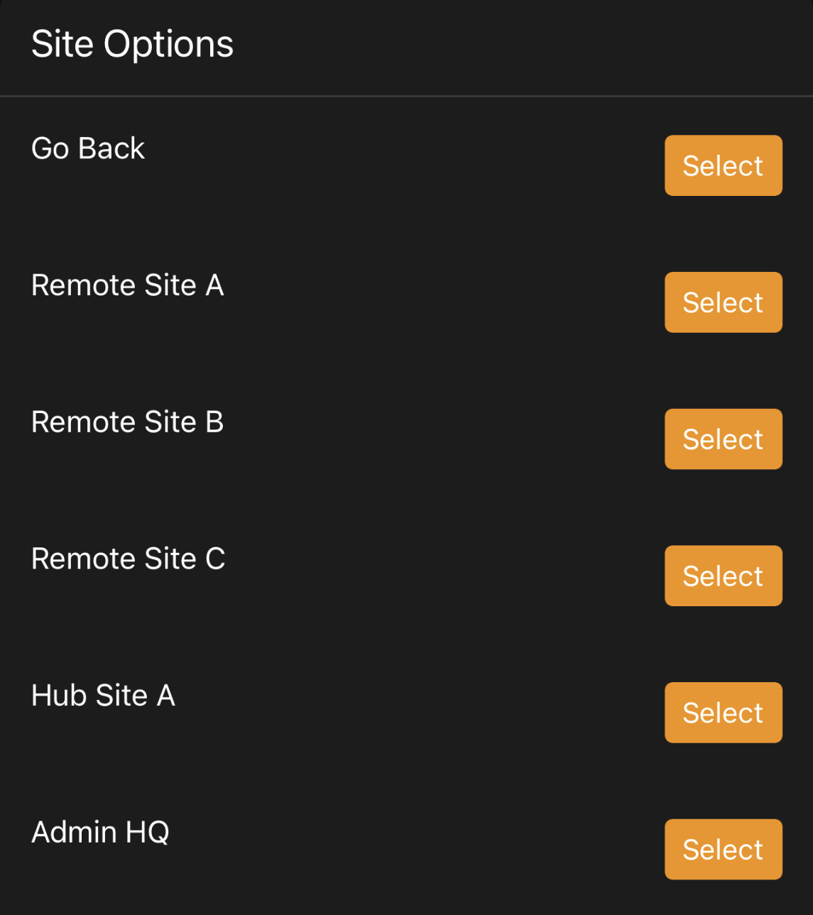
Search for a Patient – By Site
Select “View Patients” from the main menu
Enter “/list” to open the main menu
Select “By Site”
Select a site to view a list of the patients associated with that site

Slide 13
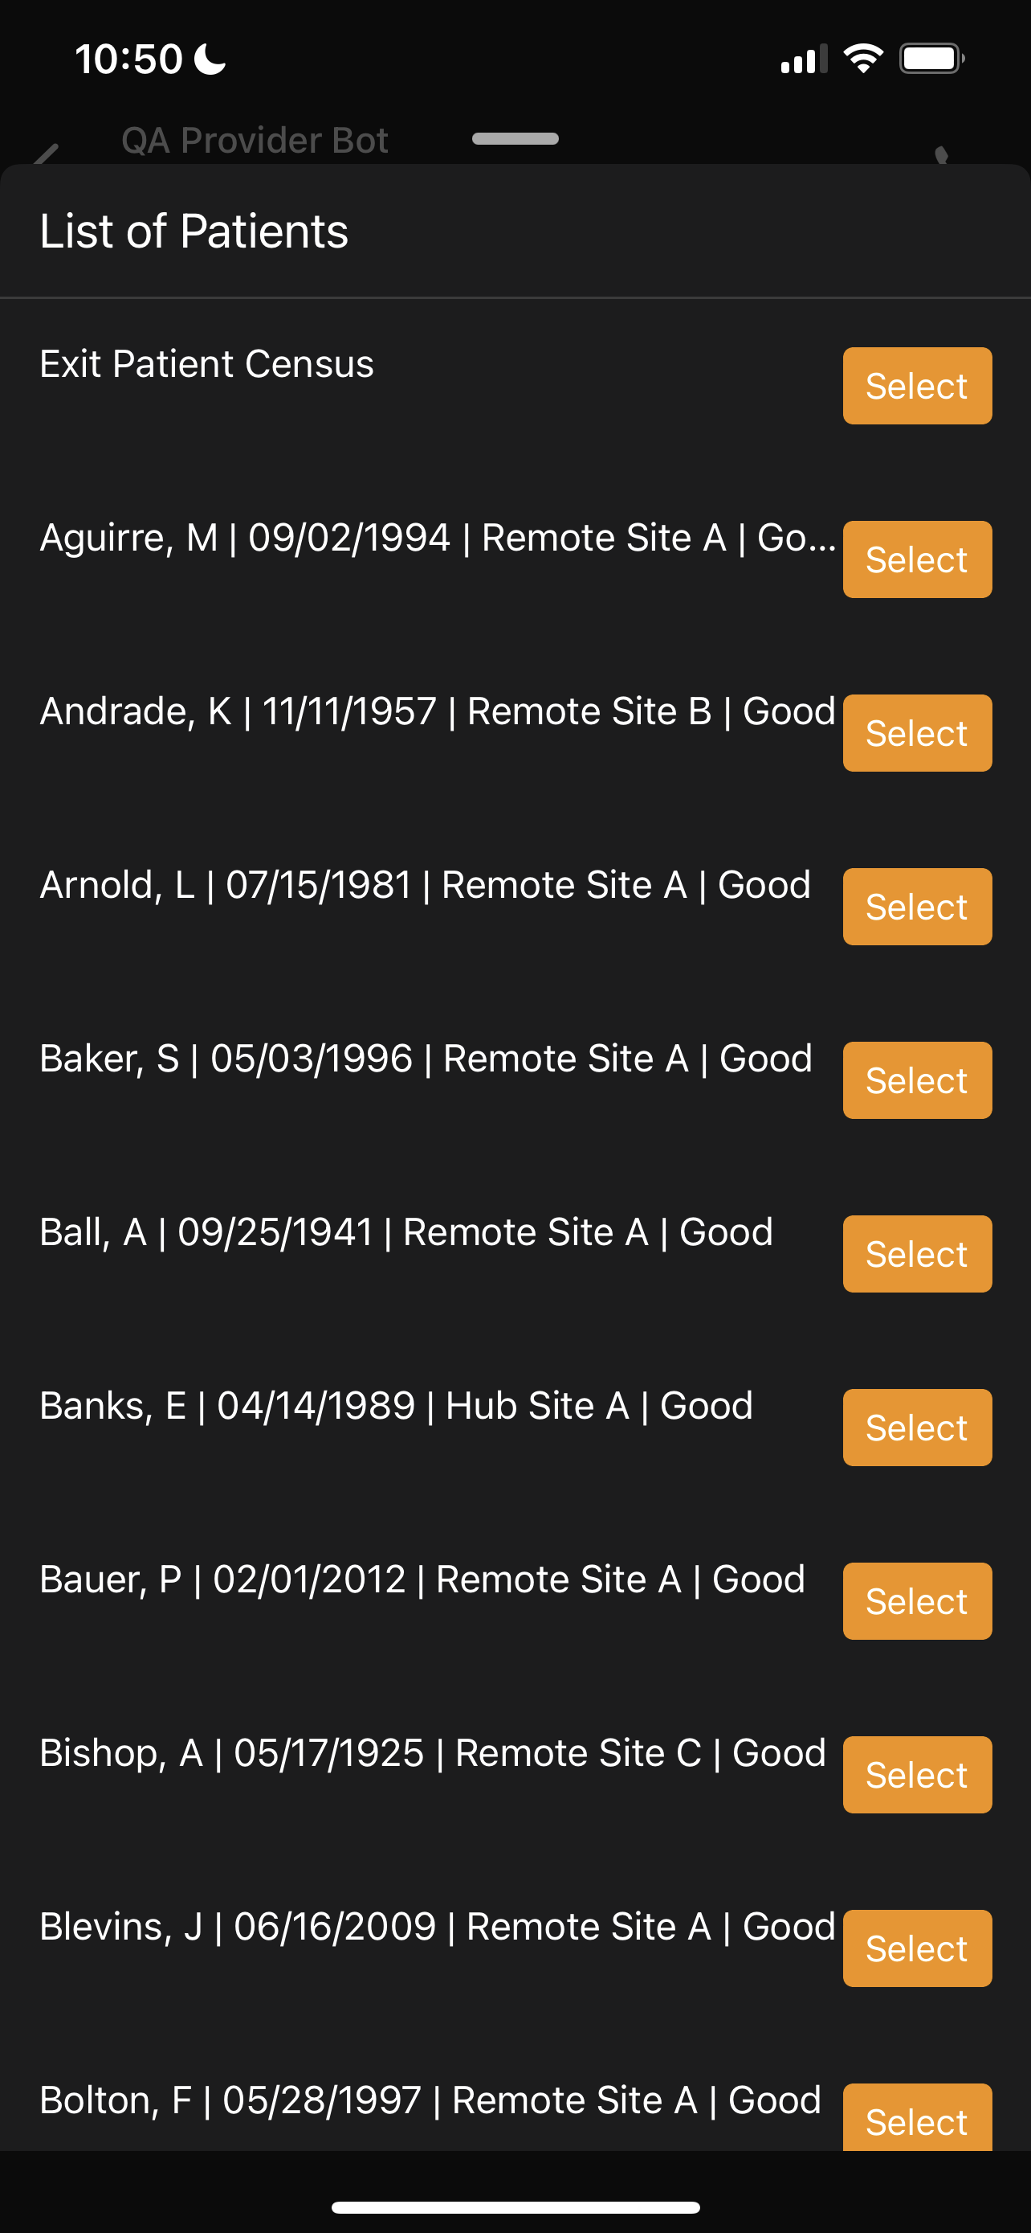
Search for a Patient – By Site Cont’d
Select the patient you wish to view and the patient record will be displayed
If there is no matching patient select “Exit Patient Census” to return to the main menu
Select the patient you wish to view from the list of patients at that site
First initial, date of birth, site, and clinical condition will be displayed

Slide 14
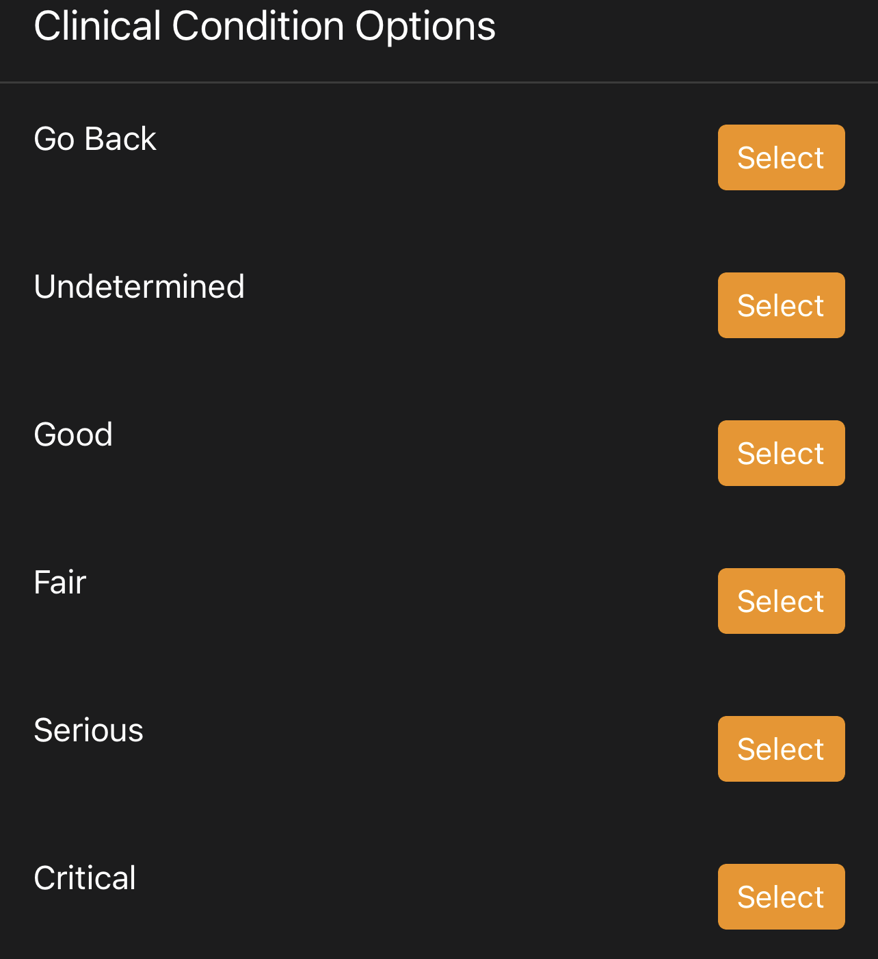
Search for a Patient – By Clinical Condition
Select “View Patients” from the main menu
Enter “/list” to open the main menu
Select “By Site”
Select a clinical condition to view a list of the patients in that condition

Slide 15
Search for a Patient – By Clinical Condition Cont’d
Select the patient you wish to view and the patient record will be displayed
If there is no matching patient select “Exit Patient Census” to return to the main menu
Select the patient you wish to view from the list of patients at that site
First initial, date of birth, site, and clinical condition will be displayed

Slide 16
Update Patient Record

Slide 17
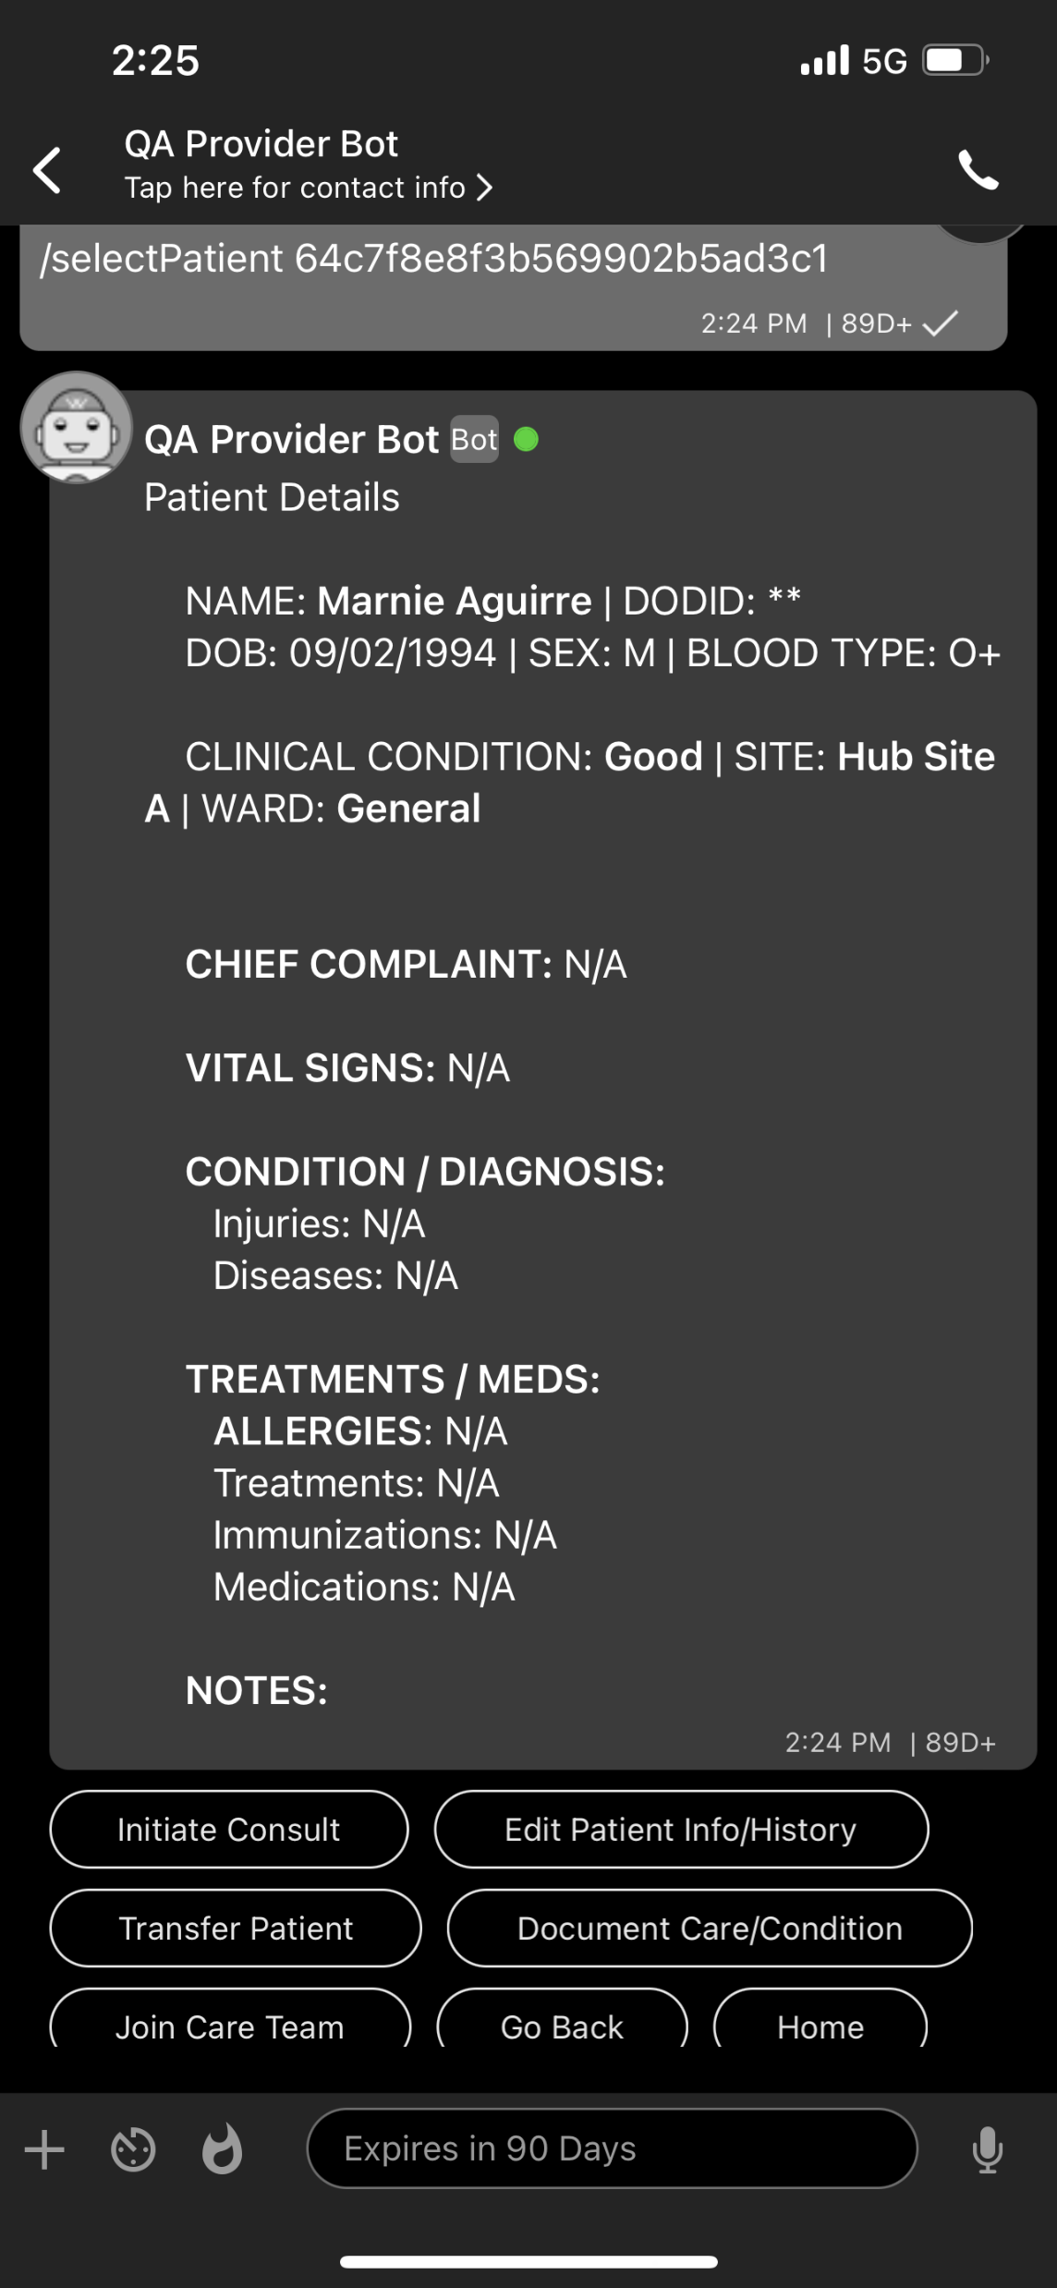
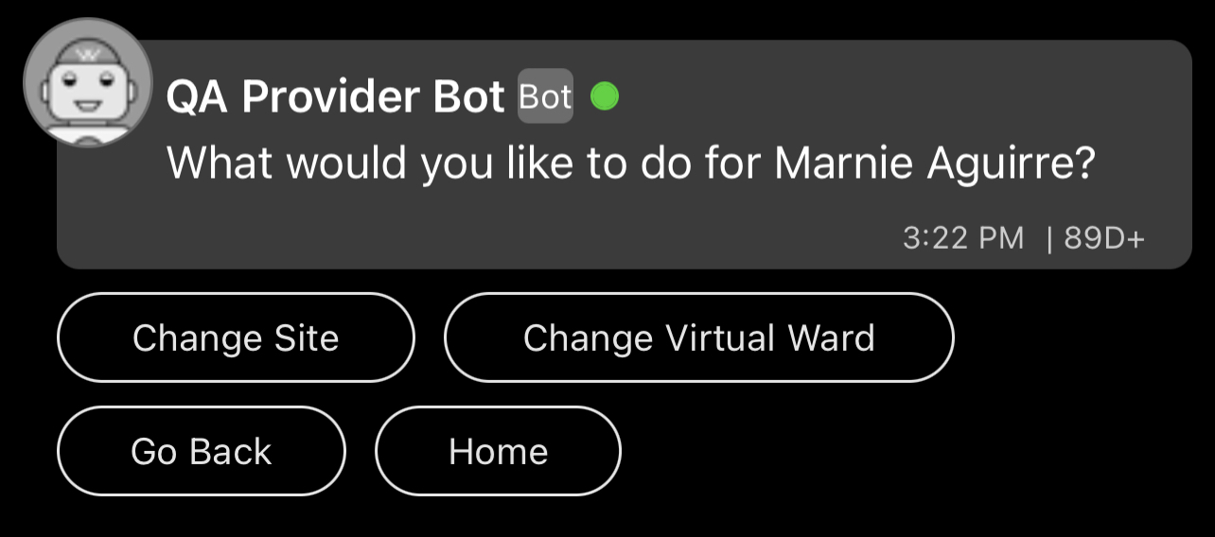
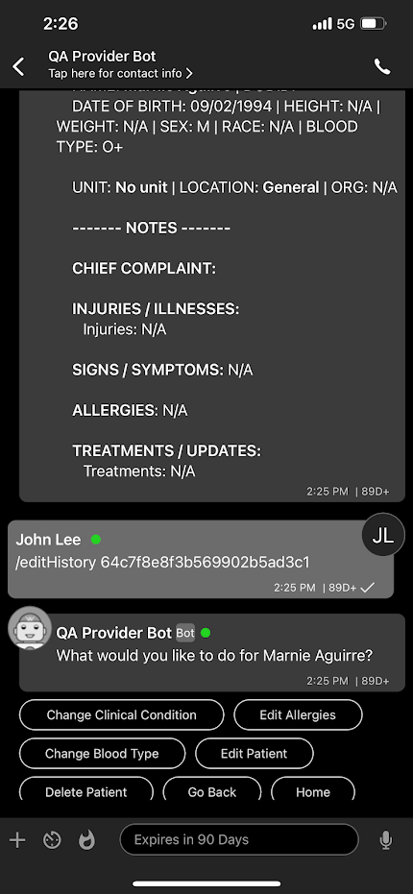
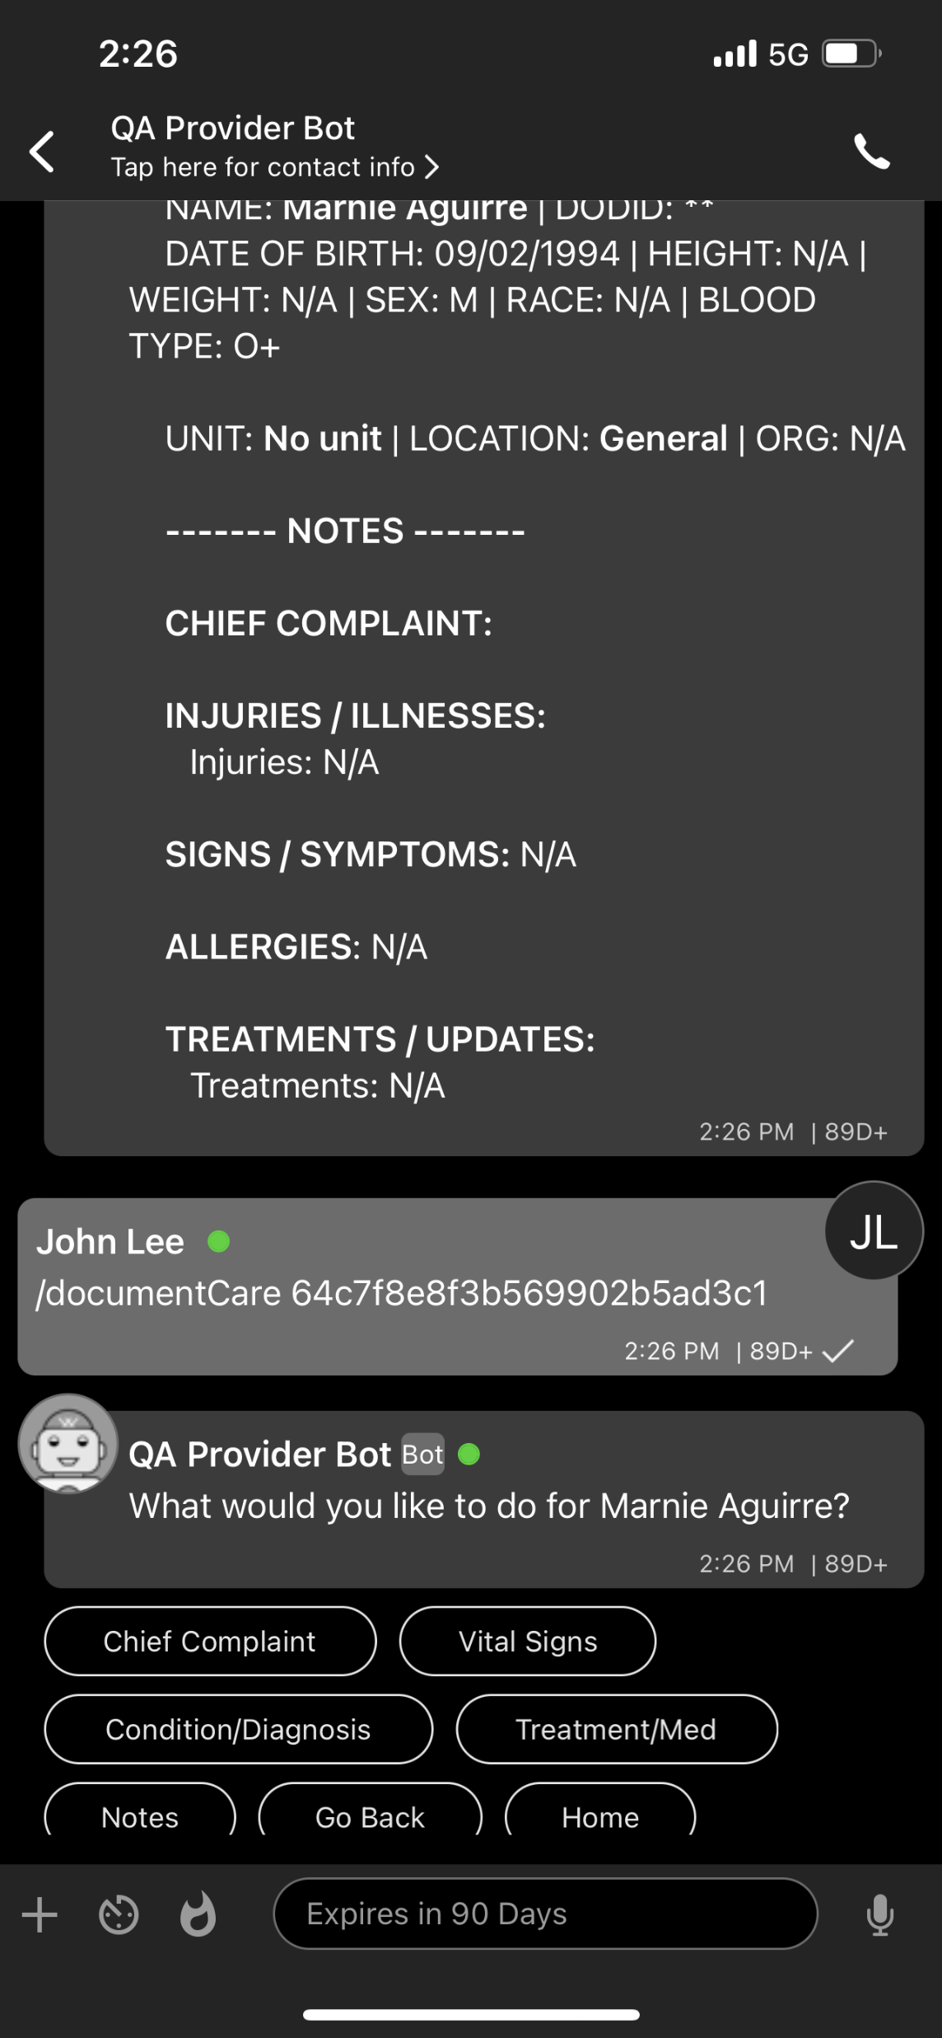

Update Patient Record
Transfer Patient
To transfer a patient select either “Change Site” or “Change Virtual Ward” and select from the displayed list. This will associate the patient with a new location and they will be visible in a list of that locations patients.
Edit Patient Info/History
To update patient name, date of birth, blood type, clinical condition, or allergies select the option, enter the update and confirm. DODID is not an editable field
Document Care/Condition
To update Chief Complaint, Vital Signs, Condition/Diagnosis, Treatments, Immunizations, Medications, or add a Note select the option, enter your data and confirm. Updates will be date/time stamped.

Slide 18
Update Patient Record – Info/History
Edit Patient Info/History
Patient name,
Date of birth,
Blood type,
Clinical condition,
Allergies
DODID is not an editable field

Slide 19
Update Patient Record – Document Care/Condition
Document Care/Condition
Chief Complaint,
Vital Signs,
Condition/Diagnosis,
Treatments,
Immunizations,
Medications,
Add a Note
Select the option, enter your data and confirm.
Updates will be date/time stamped.

Slide 20
Update Patient Record – Transfer Patient
Transfer Patient
To transfer a patient select either “Change Site” or “Change Virtual Ward” and select from the displayed list. This will associate the patient with a new location and they will be visible in a list of that locations patients.

Slide 21
Patient Consults

Slide 22
Teleheath Consultations
Text or audio-visual conferencing with specialist and other providers
Telehealth Consult Features
Text based chat with copy and paste
Audio Conferencing
Video Conferencing
End to End encryption to protect patient data
Photo and file attachment
General Consults
View providers by specialty and duty status. Conduct a consultation with an on duty provider
Shift Planning and Scheduling
Schedule shifts in advance or sign in without scheduling to show that you are online and available for a consult
View a list of providers by specialty and avalablility
Patient Consults
Start a consult with a provider of a specific specialty from a patient encounter. Share patient details with on duty providers sorted by specialty.

Slide 23
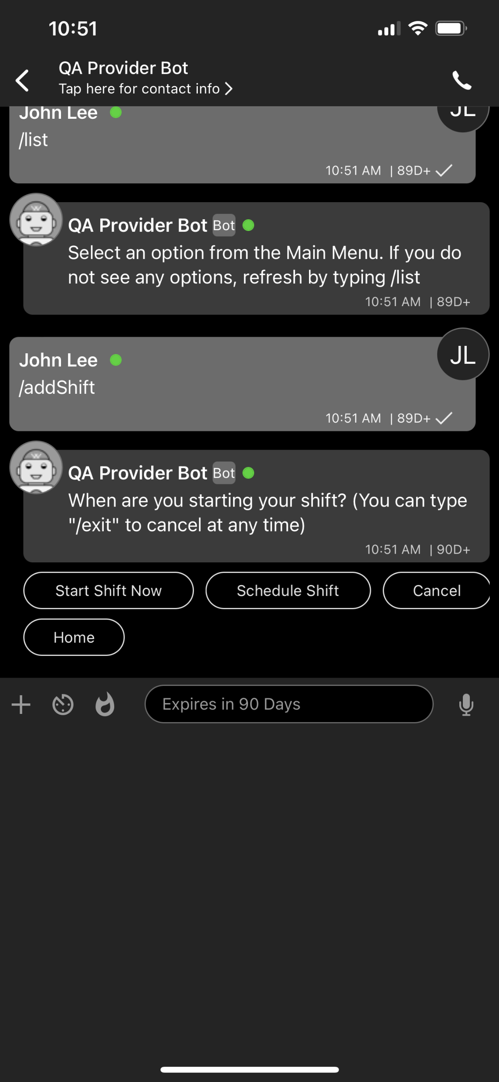
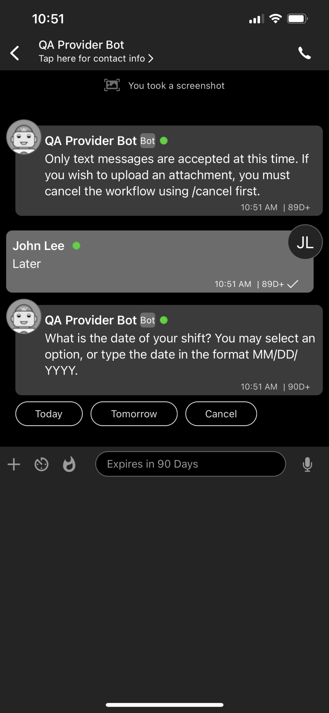
Consultations – Schedule Shift
To show you are available on the providers list you must be on shift.
To be shown as “On Duty” you must start or schedule a shift from the main menu.
Select “Schedule Shift” to schedule a shift in the future
Select either “Today” “Tomorrow” or enter a date.
E.g. 05/04/2023

Slide 24
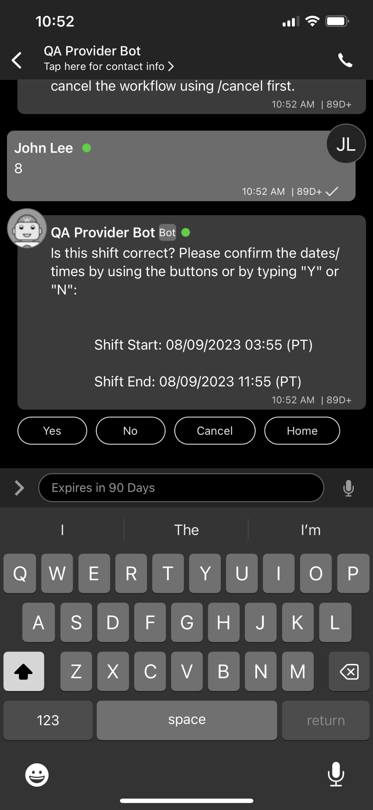
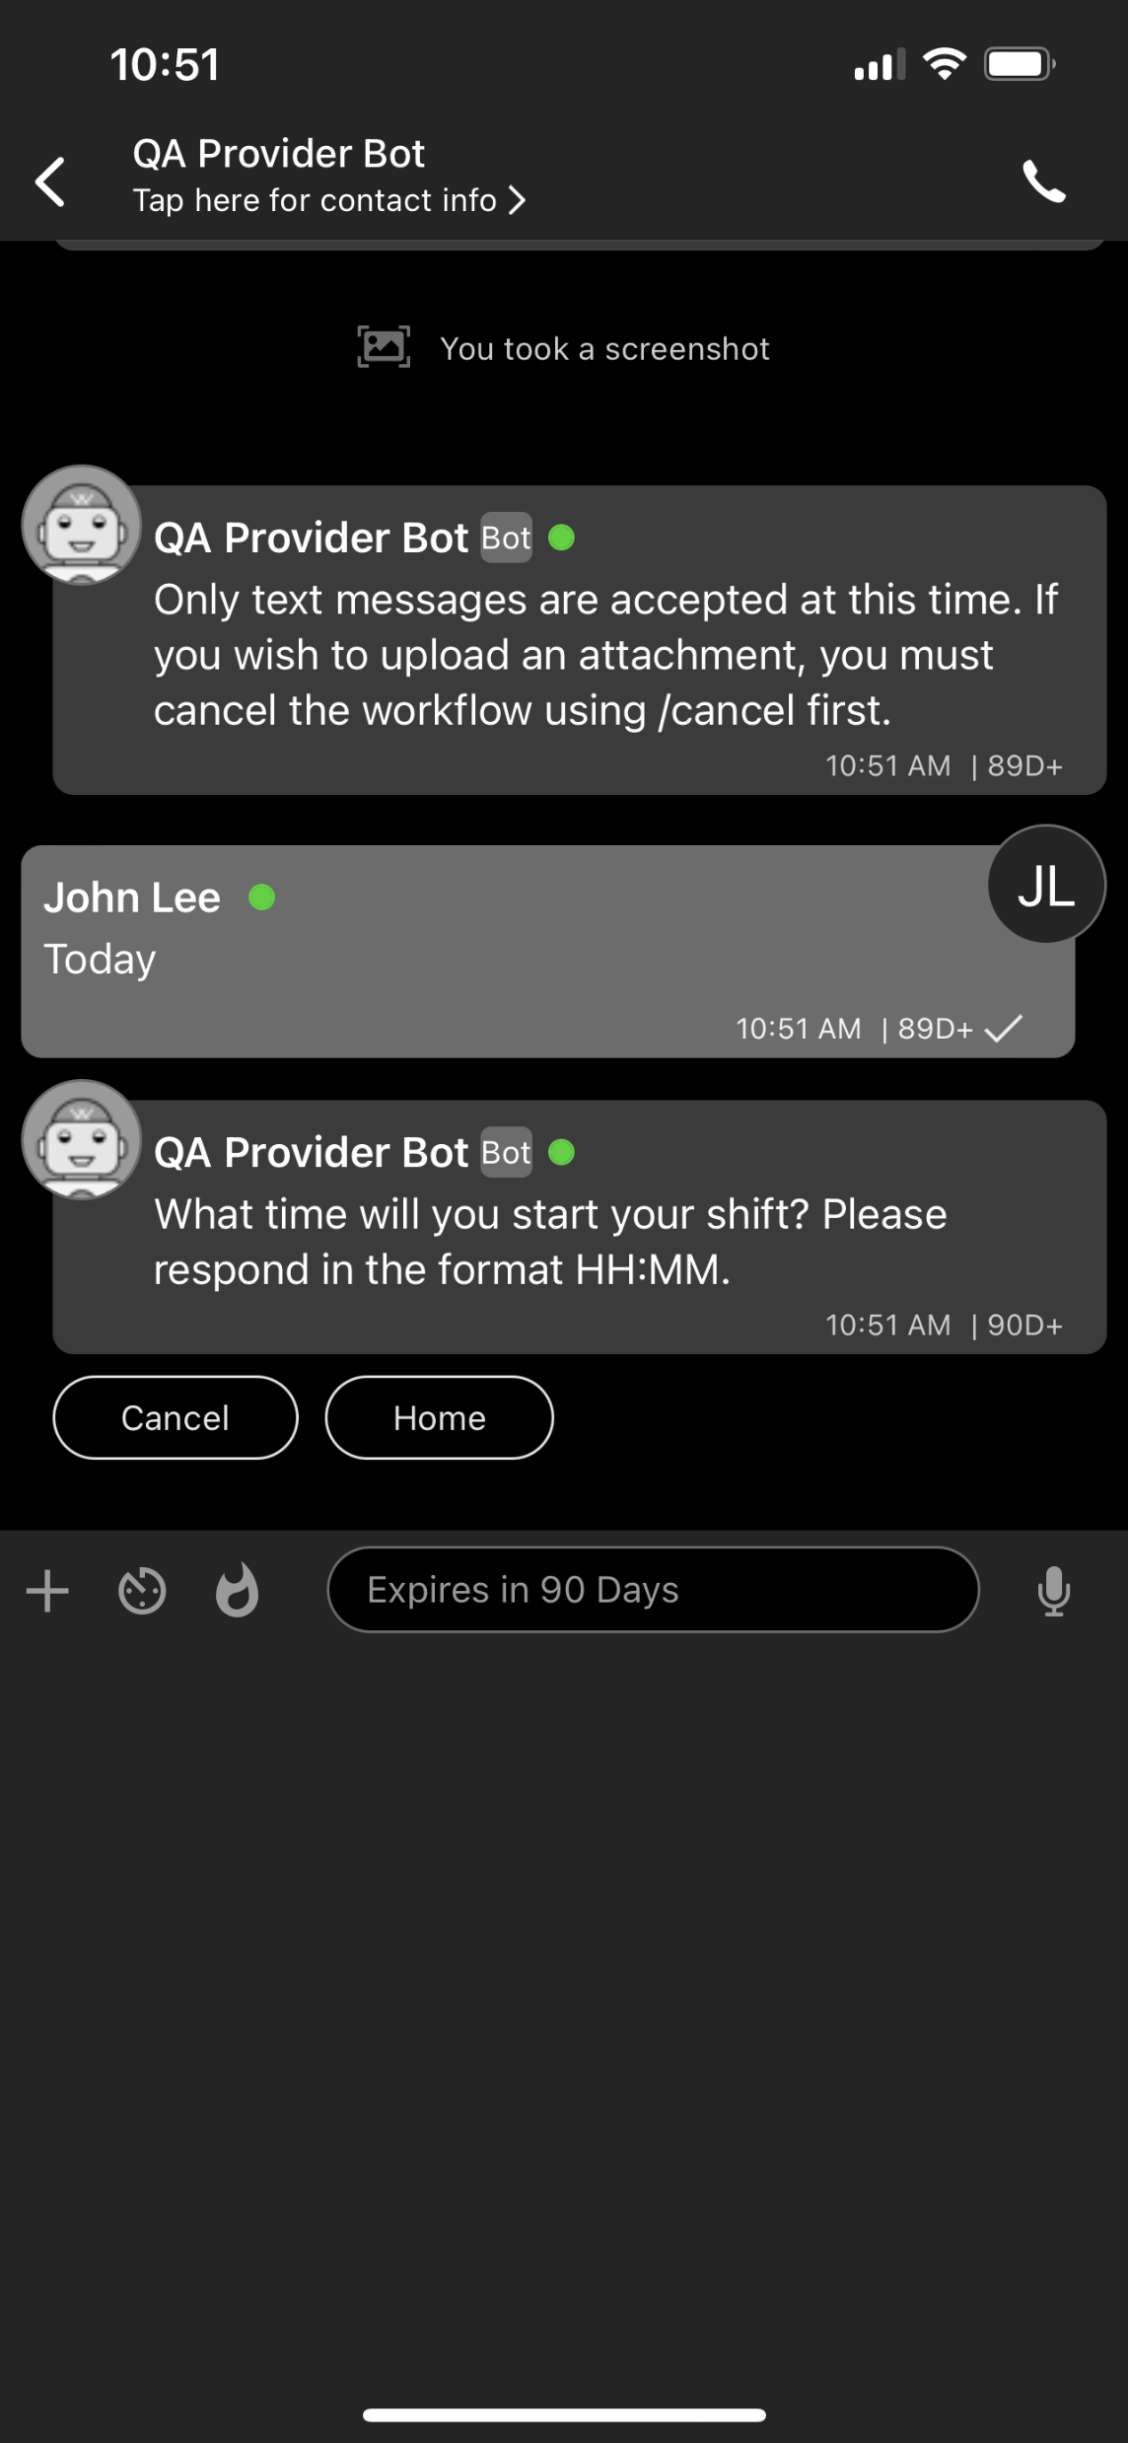
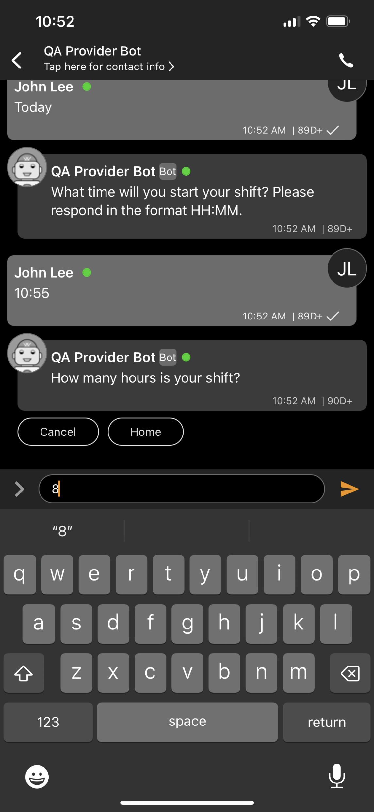

Consultations – Schedule Shift
Non-patient specific consults with on duty providers sorted by specialty
Confirm your shift or select “No” to edit your shift times
14:30
Enter a time your shift will start.
E.g. 14:30
Enter how many hours your shift will be
E.g. 8
Your shift will be confirmed

Slide 25
Consultations – Start Shift
Enter how many hours your shift will be
E.g. 8
To be shown as “On Duty” you must start or schedule a shift from the main menu.
Select “Schedule Shift” to schedule a shift in the future
Your shift will be confirmed

Slide 26

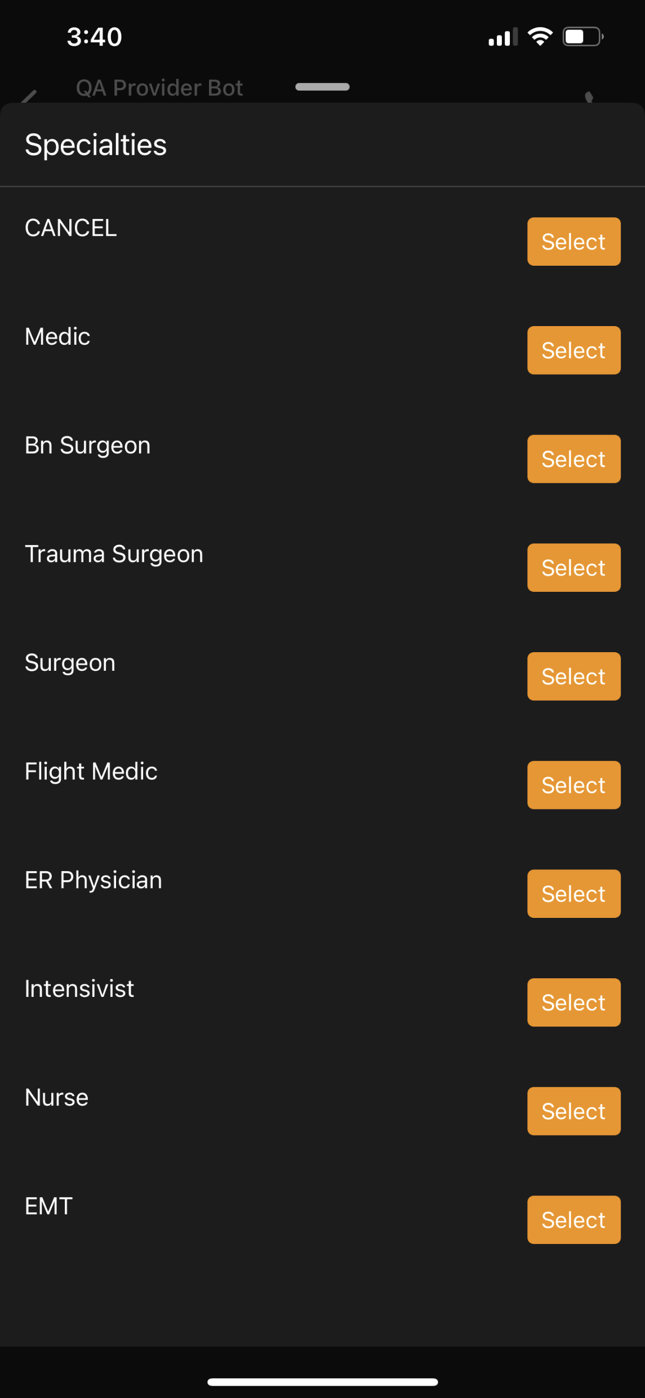
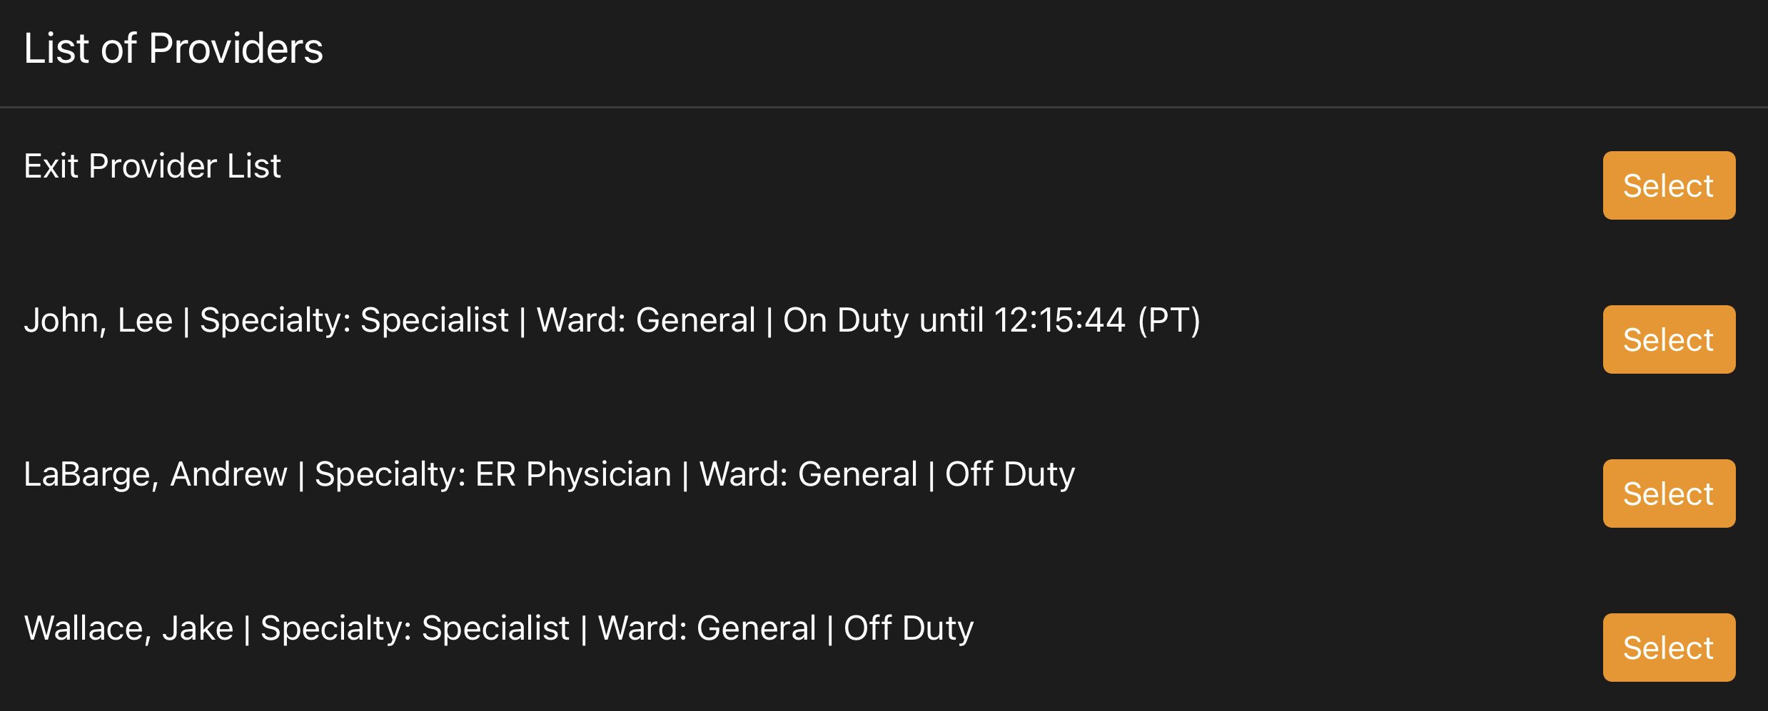
General Consultations - Mobile
Non-patient specific consults with on duty providers sorted by specialty
From the main menu select Create Specialist Consult and Select the specialty needed
To reach the menu type “/list”.
Select the on duty providers you would to begin a conference with

Slide 27
Patient Specific Consultations - Mobile
Patient specific consults with on duty providers sorted by specialty
From the main menu select Create Specialist Consult and Select the specialty needed
To reach the menu type “/list”.
Select the on duty providers you would to begin a conference with

Slide 28
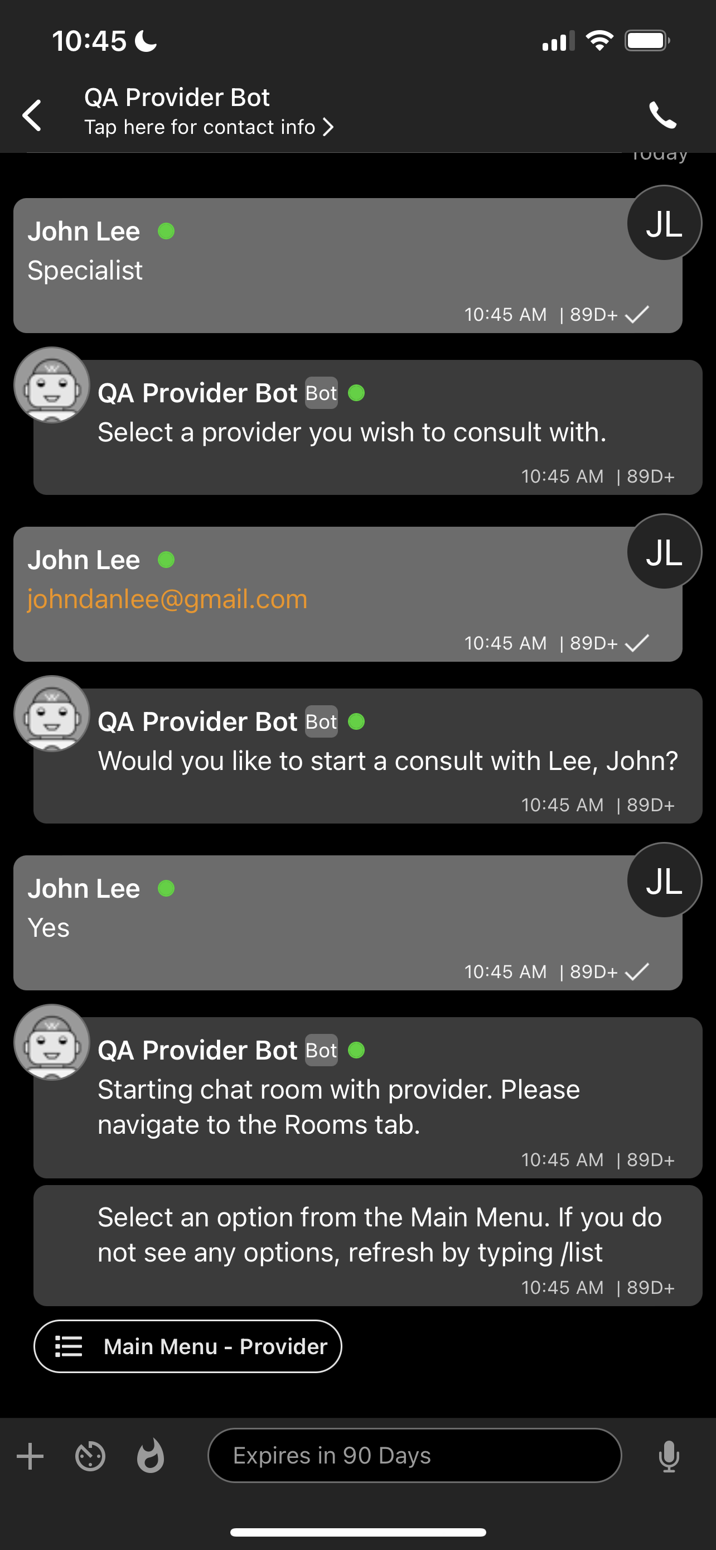
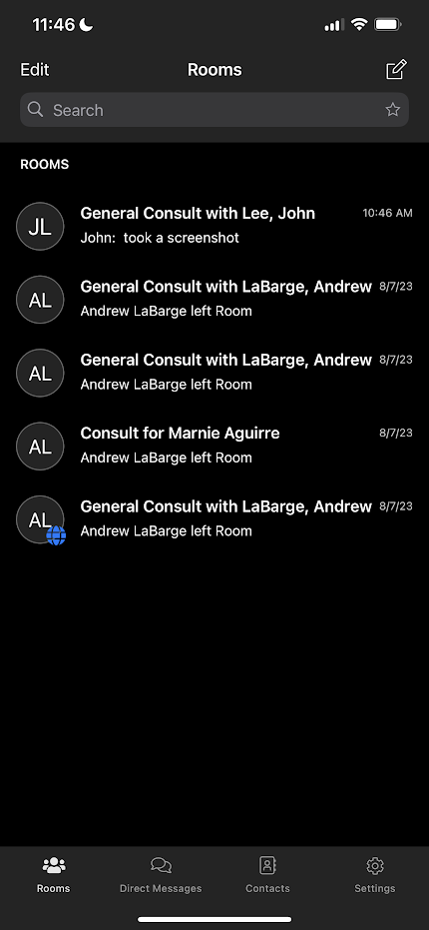
Telehealth Consultations - Mobile
Confirm that you want to start a consult and then navigate to the “rooms” tab by pressing the back arrow and selecting “Rooms”
The consult room that you have just created will be at the top of the list
The only difference between Patient specific and General consults is that the Patient consult will contain the patient record and will have the patient name in the room name.
All record updates will need to happen from the home screen, record cannot be updated from within the consult room

Slide 29
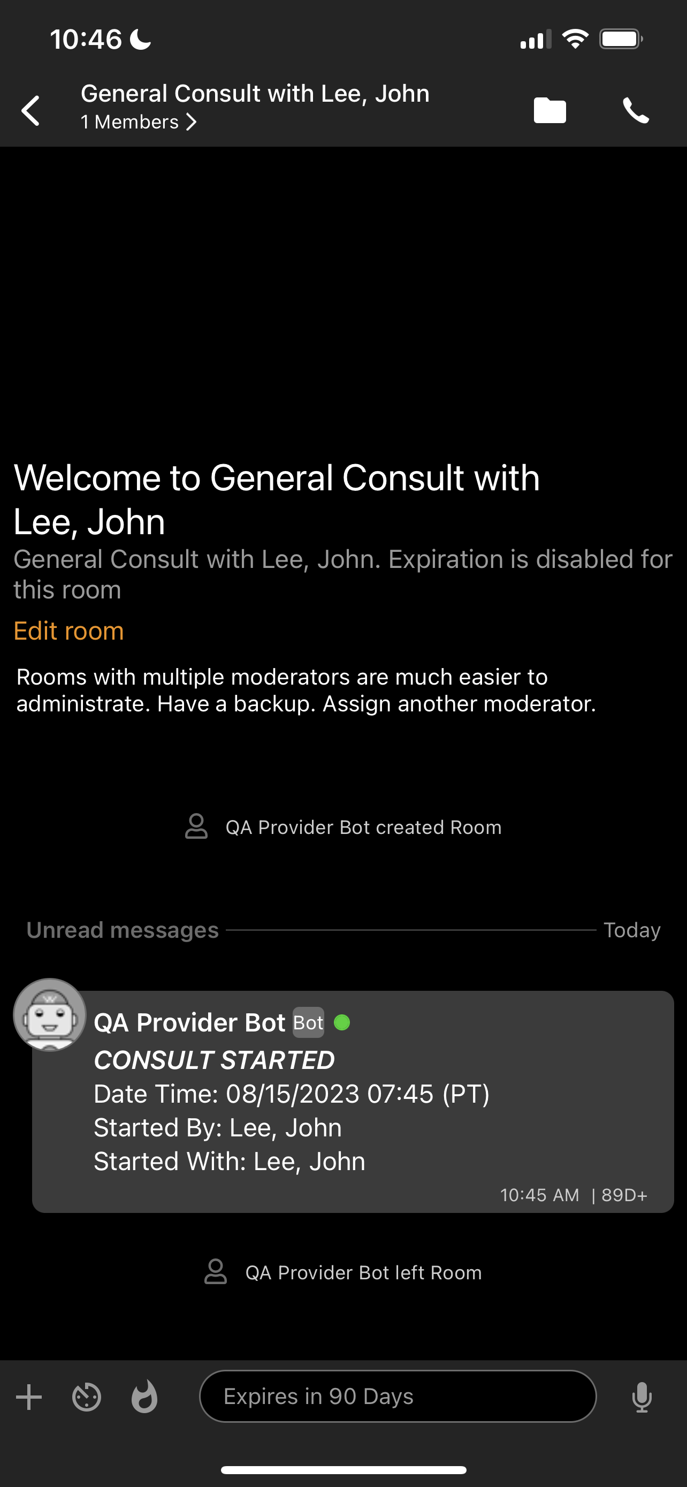
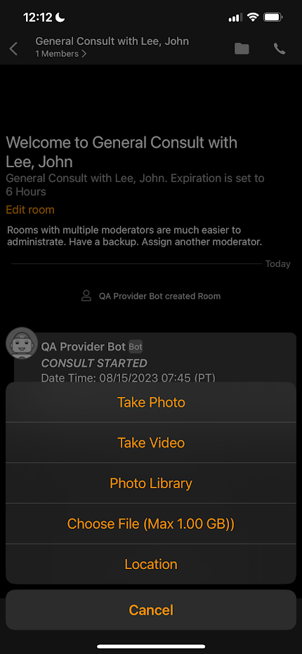
Telehealth Consultations – Mobile chat room
To start a video or audio call press the phone icon
Type a message or hold the microphone icon to record a voice memo
Press the “+” to take a photo, video, add a photo, add a file, or share location

Slide 30
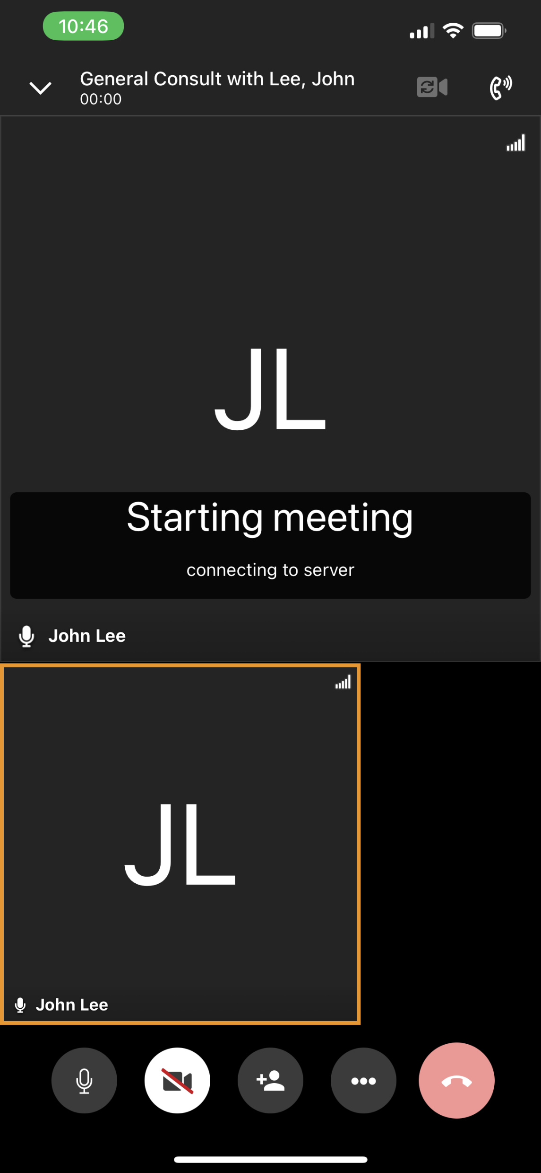
Telehealth Consultations – Mobile Voice and Video Call
Switch between speaker and handset
Switch between front and back camera
Consulting Provider
To mute/unmute audio, start/end video, add additional participants or end the call use the buttons on the bottom of the screen
To disable/enable participant video or mute specific participants press the “…” button
You

Slide 31
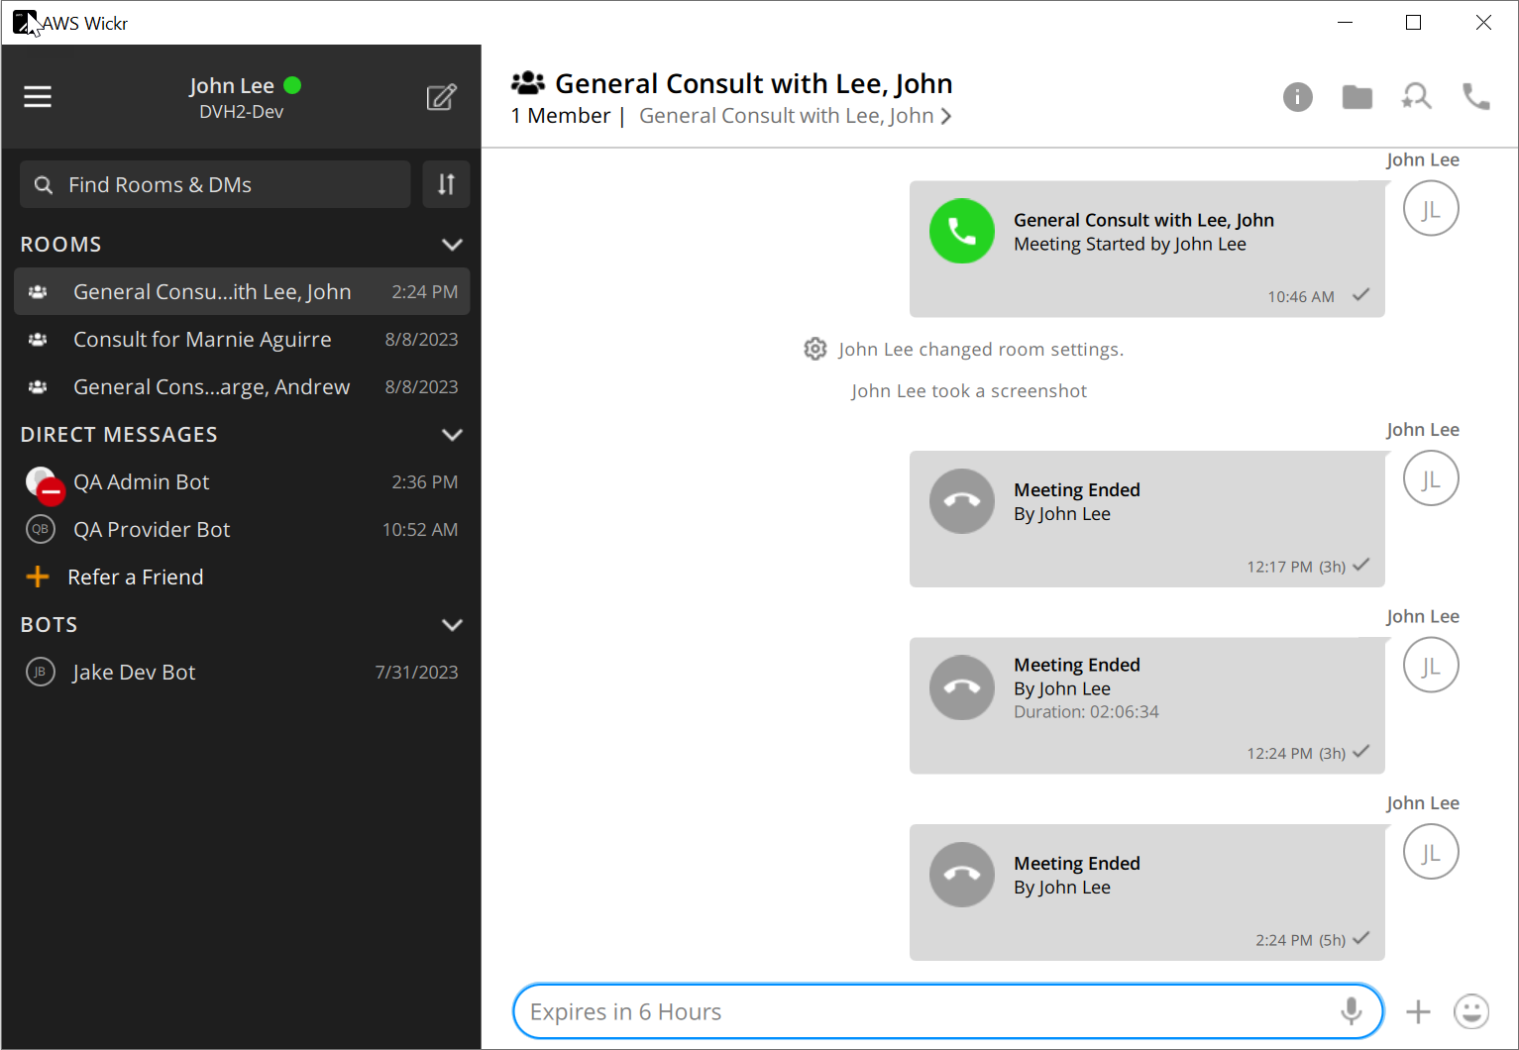
Telehealth Consultations – Desktop Chat
Add Files, Search Chat, or Start Call
The consults will be listed under “Rooms” on the left side of AWS Wickr
Just like the mobile application, consults initiated from within the patient record will be patient specific, general consults from the main menu will not

Slide 32
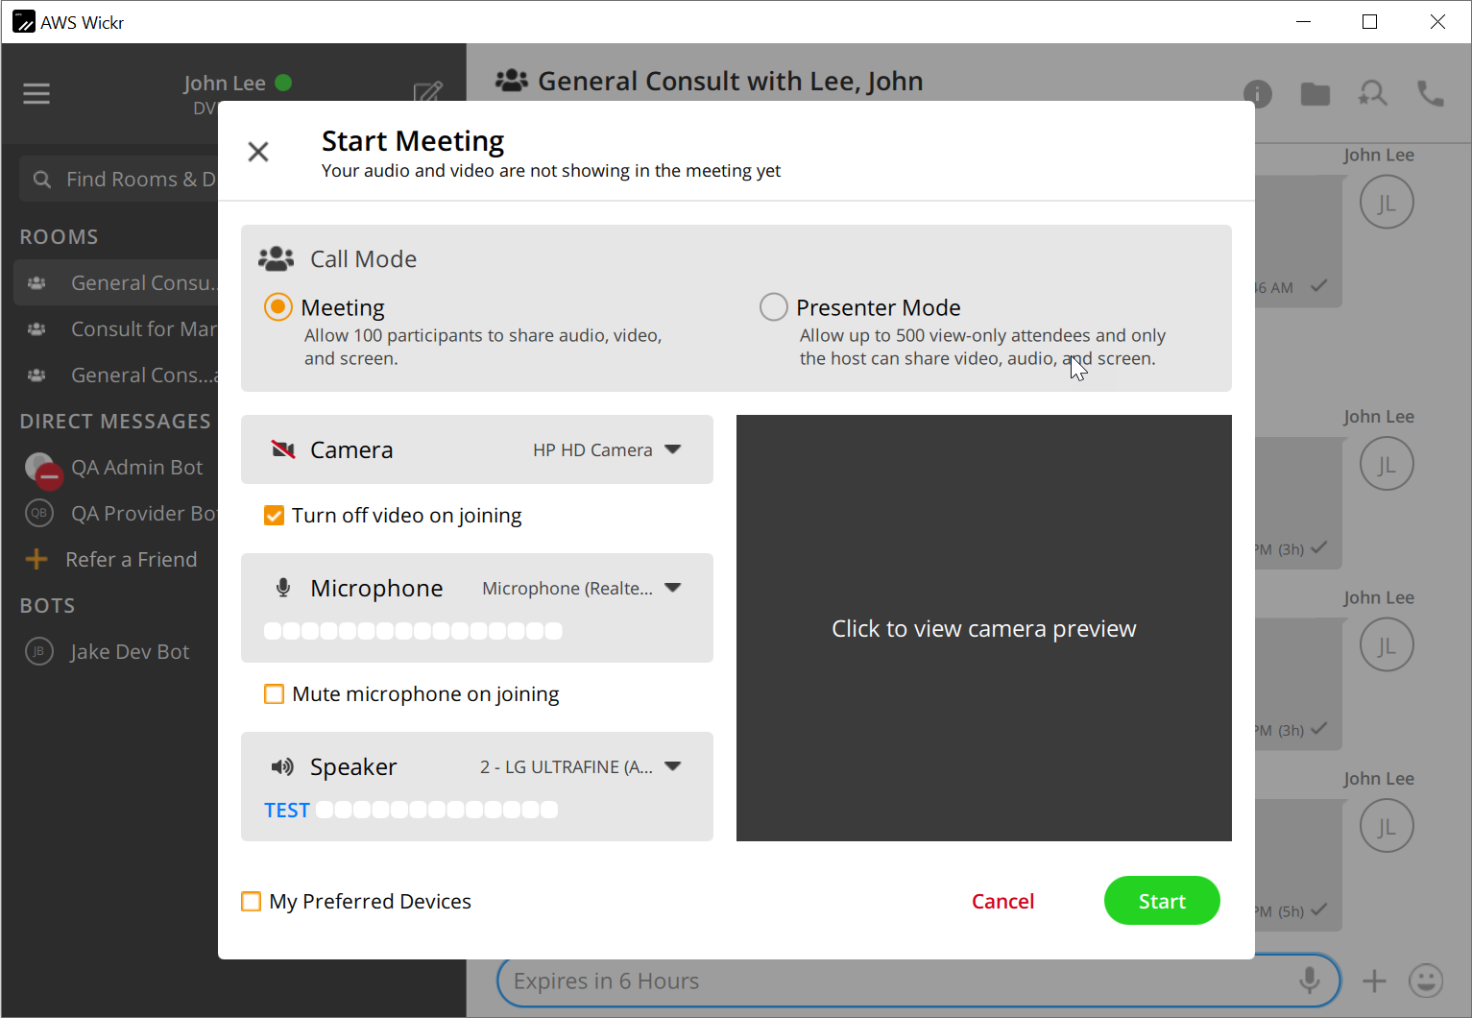
Telehealth Consultations – Desktop Voice and Video call
When initiating a call a “Start Meeting” dialog will display
From this screen you can:
Switch between participatory meetings and view only presentations
Test camera and microphone settings
To confirm your settings and begin the meeting press “Start”

Slide 33
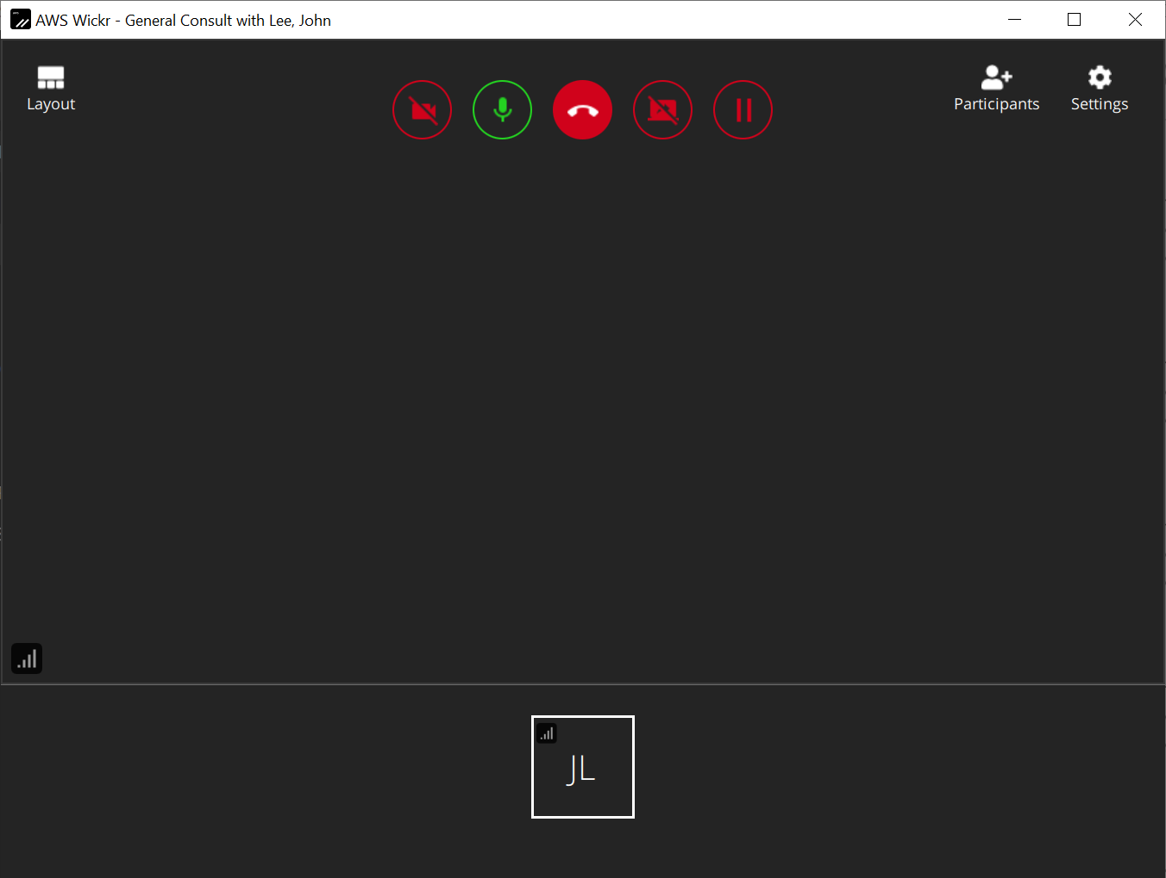
Telehealth Consultations – Desktop Voice and Video call
To enable/disable camera and microphone, share screen, pause call, or end meeting use the buttons on the top row
Telehealth consultations can contain up to 100 participants in meeting mode and 500 attendees in view only presenter mode.
Participants can be added, removed, or muted from the participants button
Camera, speakers, and microphone, settings can be controlled from the settings button
Other Participants
You

Slide 34
Questions?

